Slide 1
TRAINING DEMO

Slide 2

STANDARD ENTRY
Notes:
Elliot –

Slide 3
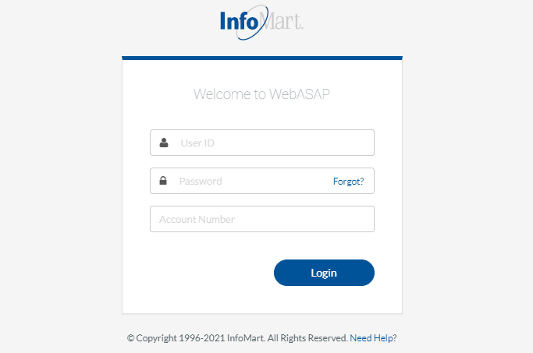
WebASAP LOGIN
STANDARD ENTRY
You will be required to provide your user ID, password, and account number each time you log in.
Please note that the password is case-sensitive and needs to be entered exactly as it was provided.

Slide 4
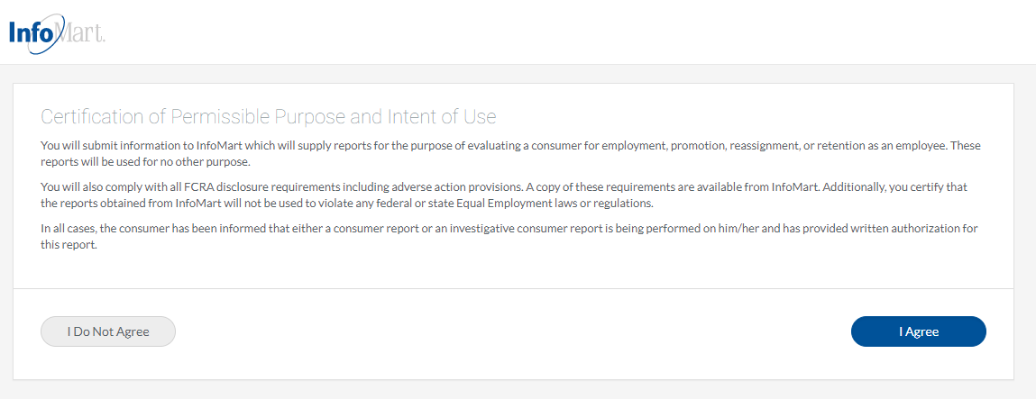
PERMISSIBLE PURPOSE
STANDARD ENTRY
Occasionally you will be required to agree to a Certification of Permissible Purpose and Intent of Use. This is where you confirm that you will only be running background checks for the reasons you stated when signing up for an account. Click I agree to continue.

Slide 5
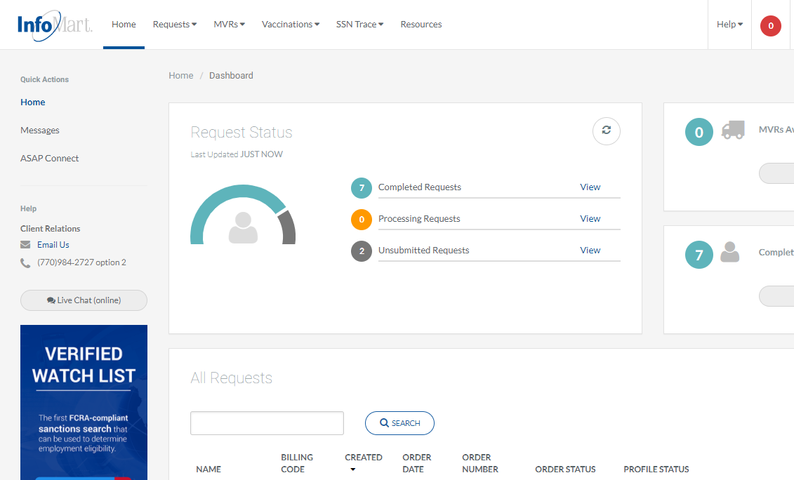
HOMEPAGE/RESOURCES
STANDARD ENTRY

Slide 6
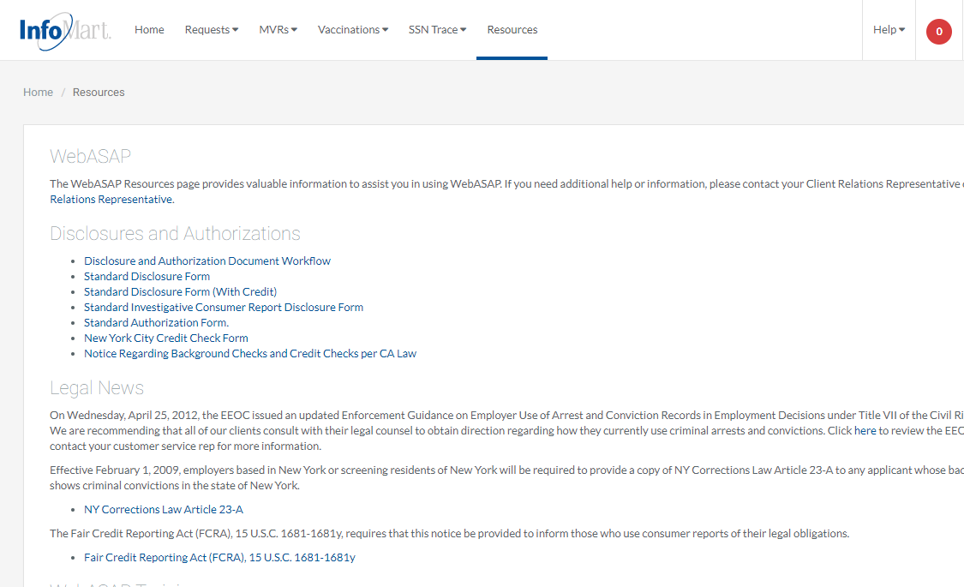
RESOURCES
STANDARD ENTRY

Slide 7
WORKFLOW
STANDARD ENTRY
NYC Credit Check Form
Standard Disclosure Form
Search Does Not Include Investigate Report Component (Personal References/Expanded Employment)
Job Located in NY
Without Credit
Standard Authorization Form
Job Located Elsewhere
With Credit
Job Located in CA
CA Law Notice Regarding Background Checks
Standard Disclosure Form (with Credit)
Search Includes Investigate Report Component (Personal References/Expanded Employment)
Standard Investigate Consumer Report Disclosure Form

Slide 8
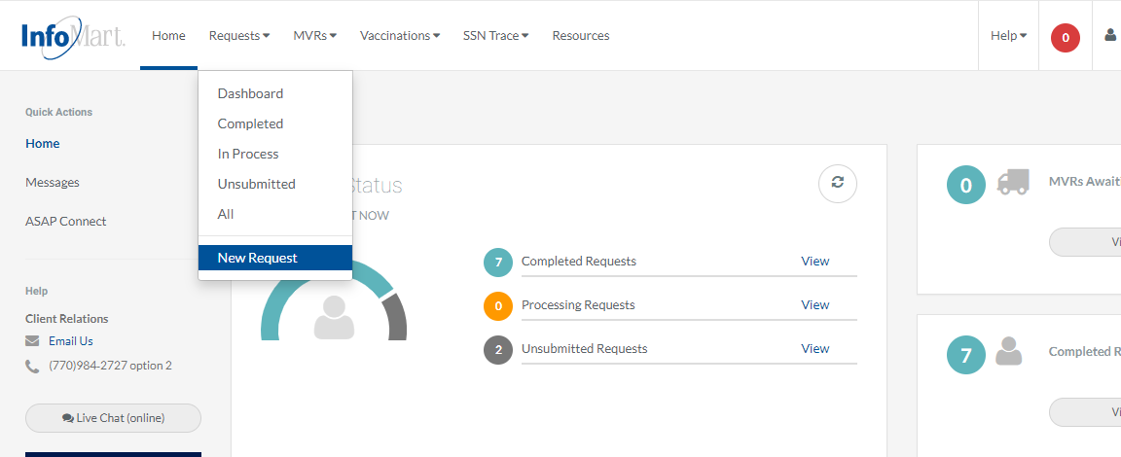
HOMEPAGE
STANDARD ENTRY
To begin the standard process of ordering a background check, click requests at the top of the page, then choose new request.

Slide 9
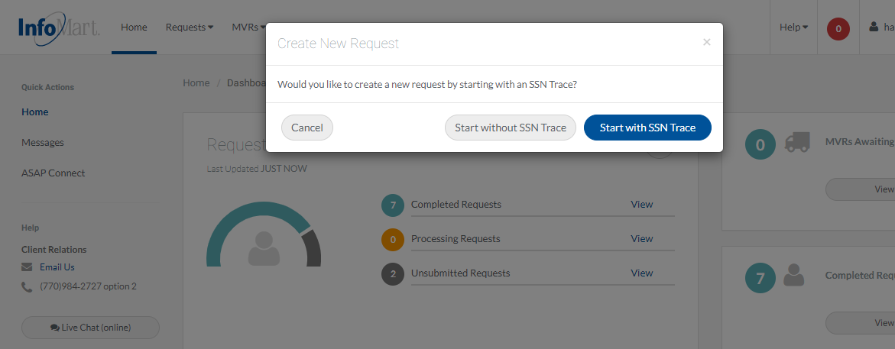
CREATING A REQUEST
STANDARD ENTRY
You will be prompted to indicate whether you would like to run the Social Security Number Trace (SSN Trace) first. The SSN Trace is used as a tool to help uncover previous addresses/jurisdictions for a criminal search to be run, and it is included in most criminal background check packages.

Slide 10
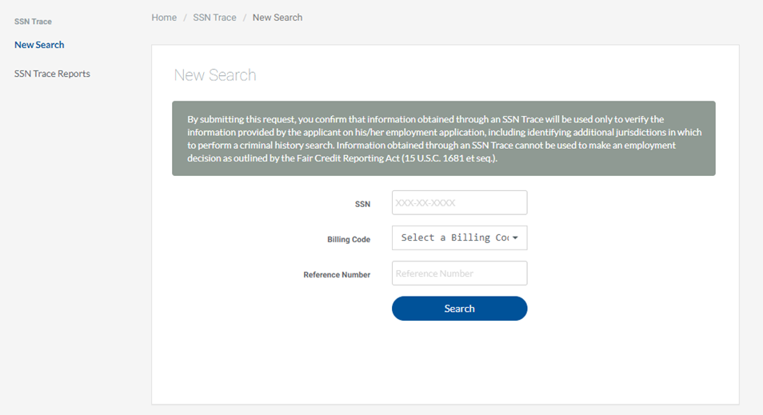
SSN TRACE SUBMISSION
STANDARD ENTRY
Enter your applicant’s Social Security Number.
If applicable, billing codes for your account will be preloaded into the dropdown menu.
The reference number field is freeform. Whatever you provide there will appear on the invoice alongside this candidate’s name.
Only the SSN is a required field. Click search when you have finished.

Slide 11
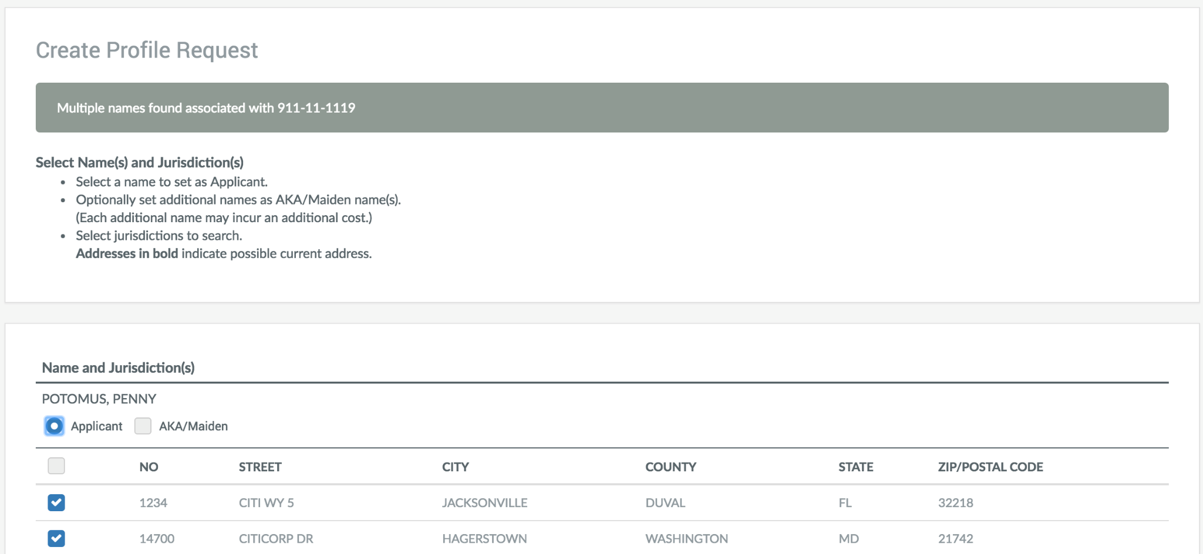
SSN TRACE RESULTS
STANDARD ENTRY
If there are multiple names that come back from the SSN Trace, they will show on this screen. Select the best match to your candidate’s name by marking applicant. Follow the instructions provided on the top left of this screen before continuing.

Slide 12
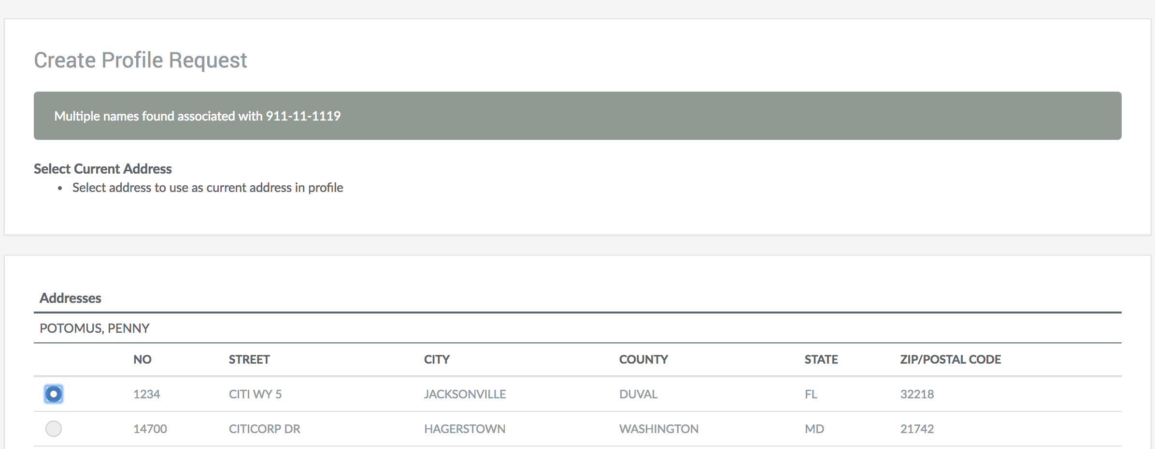
SSN TRACE RESULTS
STANDARD ENTRY
Often, you will see the candidate’s current address on this screen. Select the button to the left of your candidate’s current address. If none of the addresses match, select the closest one – you will be able to modify the address later in the process.

Slide 13
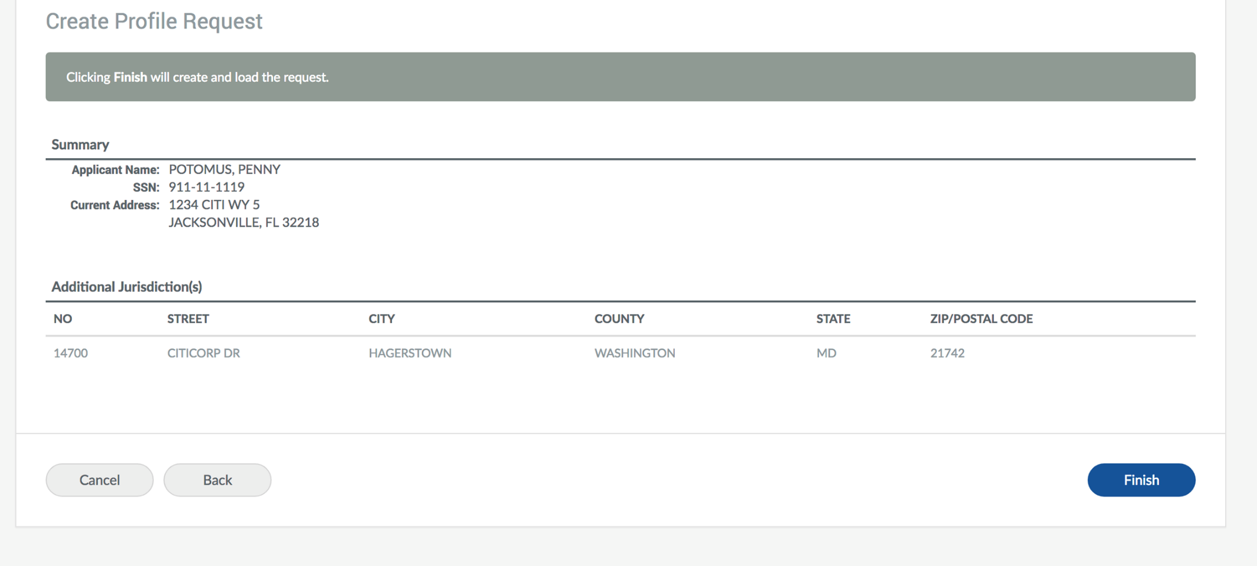
SSN TRACE REVIEW
STANDARD ENTRY
The information provided thus far will be compiled for you to review. Click finish if everything appears correct (again, if the address is wrong, you will be able to change it later), otherwise you can click the back button to make changes.

Slide 14
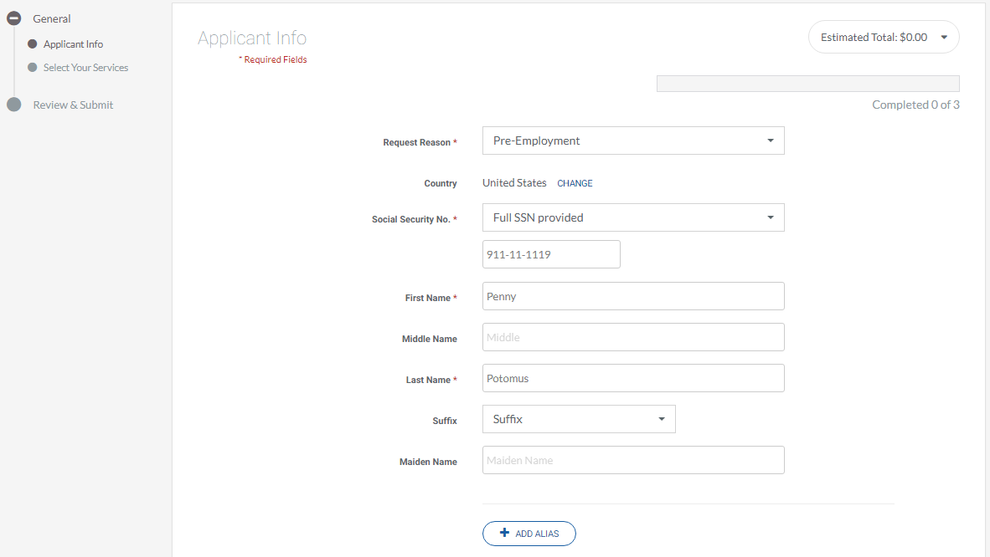
APPLICANT INFORMATION
STANDARD ENTRY
The identifiers you have provided thus far will be pre-populated for you on the applicant info screen. If they were correct, they can be left as is, otherwise please update them as you go. For the best results, complete each field on this page, whether required or not.
The add alias button should only be used if you want to run your check on more than one name (same goes with the maiden name above).
*Please note that screening additional names may incur additional charges.

Slide 15
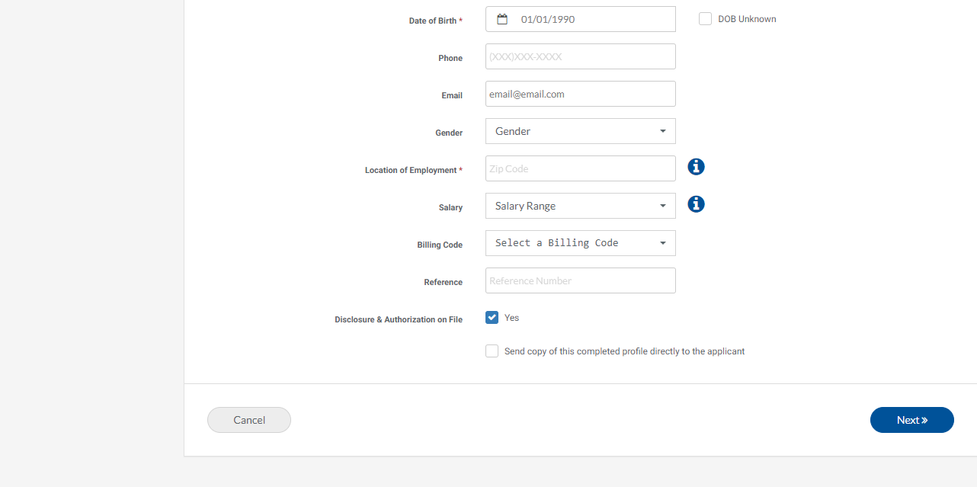
APPLICANT INFORMATION
STANDARD ENTRY
Email address should be the applicant’s email, not the person ordering the check (unless they are the same person).
Location of employment is a required field. This allows InfoMart to apply the appropriate state/city rules where applicable.
Disclosure & authorization on file is a mandatory field; a background check cannot legally be requested on a candidate unless that individual has completed a disclosure & authorization form. Select Yes if you have the candidate’s signed disclosure & authorization form before clicking next to continue.

Slide 16
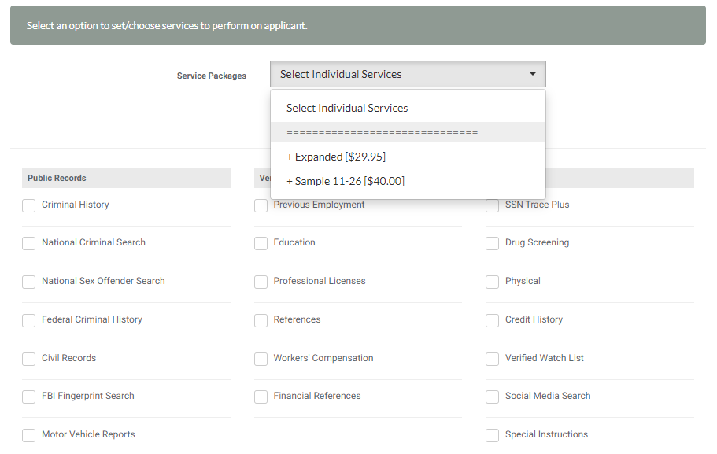
PACKAGE SELECTION
STANDARD ENTRY
You can select the appropriate service package from the dropdown on the top of the screen.
Package price will show if applicable and your estimated running total can be found at the top right of the screen.

Slide 17
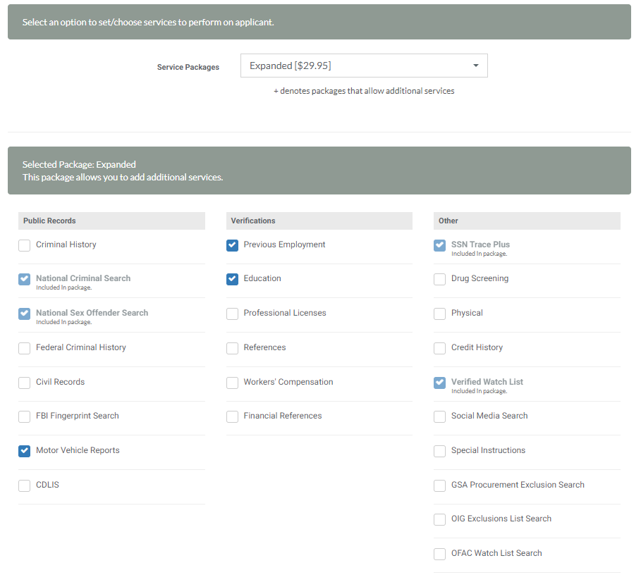
PACKAGE SELECTION
STANDARD ENTRY
Choosing a package will automatically select the appropriate services included in that package below.
You can add services by checking the box next to the individual service.
*Keep in mind that the National Sex Offender Search will automatically be run when the National Criminal History is ordered, as it is included.

Slide 18
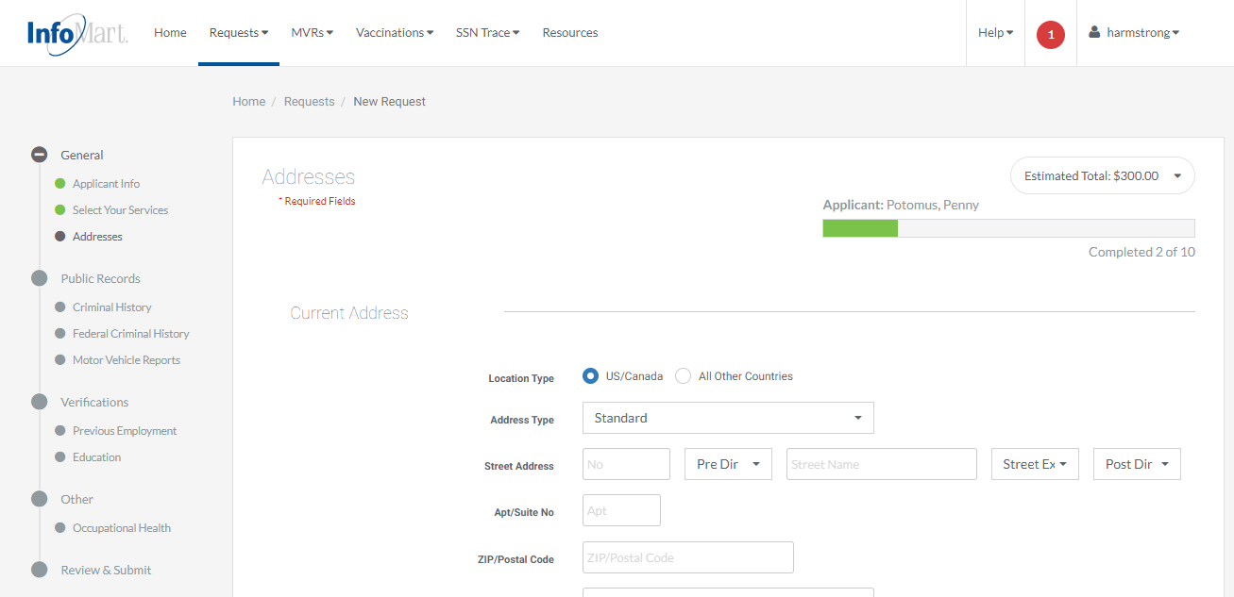
NEW REQUEST OUTLINE
STANDARD ENTRY

Slide 19
CURRENT ADDRESS
STANDARD ENTRY
The current address you selected during the SSN Trace process will pre-populate here. If it was correct, you can click next. If not, please update it before clicking next.

Slide 20
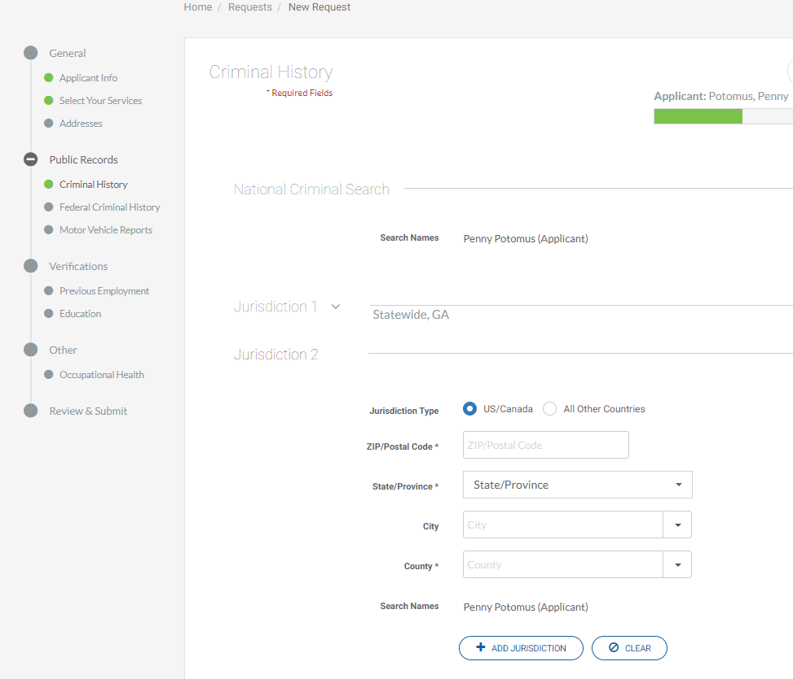
ADDING CRIMINAL JURISDICTIONS
STANDARD ENTRY
Jurisdictions discovered by the SSN Trace will populate automatically with the appropriate search. If you need to add a jurisdiction, there will be an additional jurisdiction space to do so automatically.
As jurisdictions are added, the estimated total will update, taking mandatory fees into consideration as well as jurisdiction costs (if applicable).

Slide 21
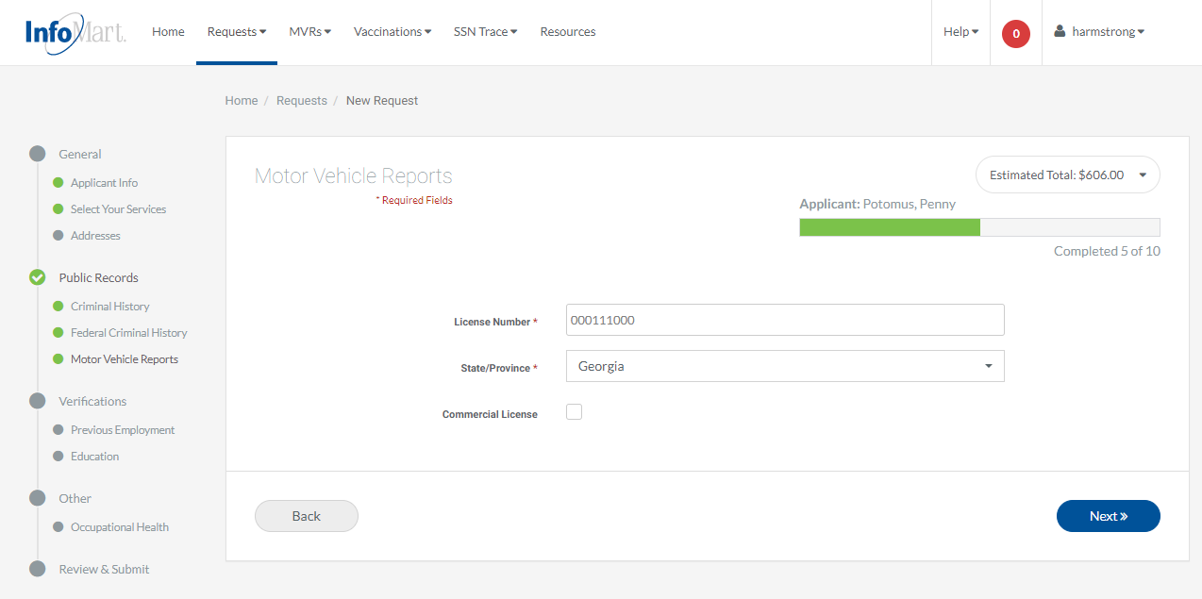
MVR
STANDARD ENTRY

Slide 22
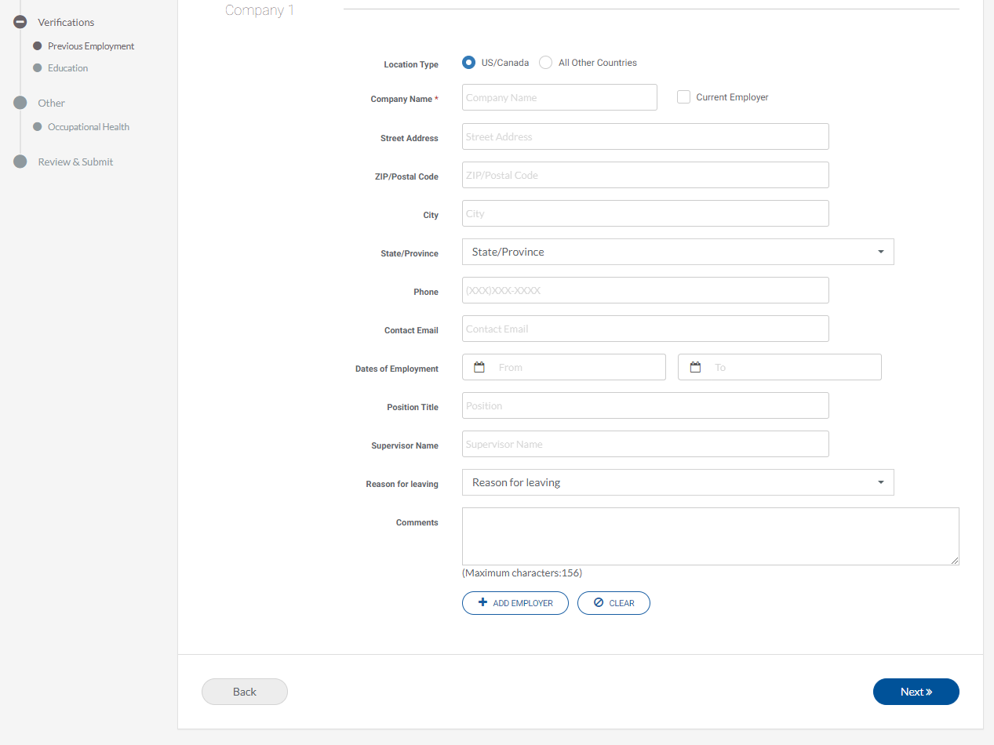
PREVIOUS EMPLOYMENT
STANDARD ENTRY
Please be as thorough as possible when providing the education information you would like verified. Type out the full school name, branch and/or address, dates of attendance and/or graduation, degree type, and major as available.

Slide 23
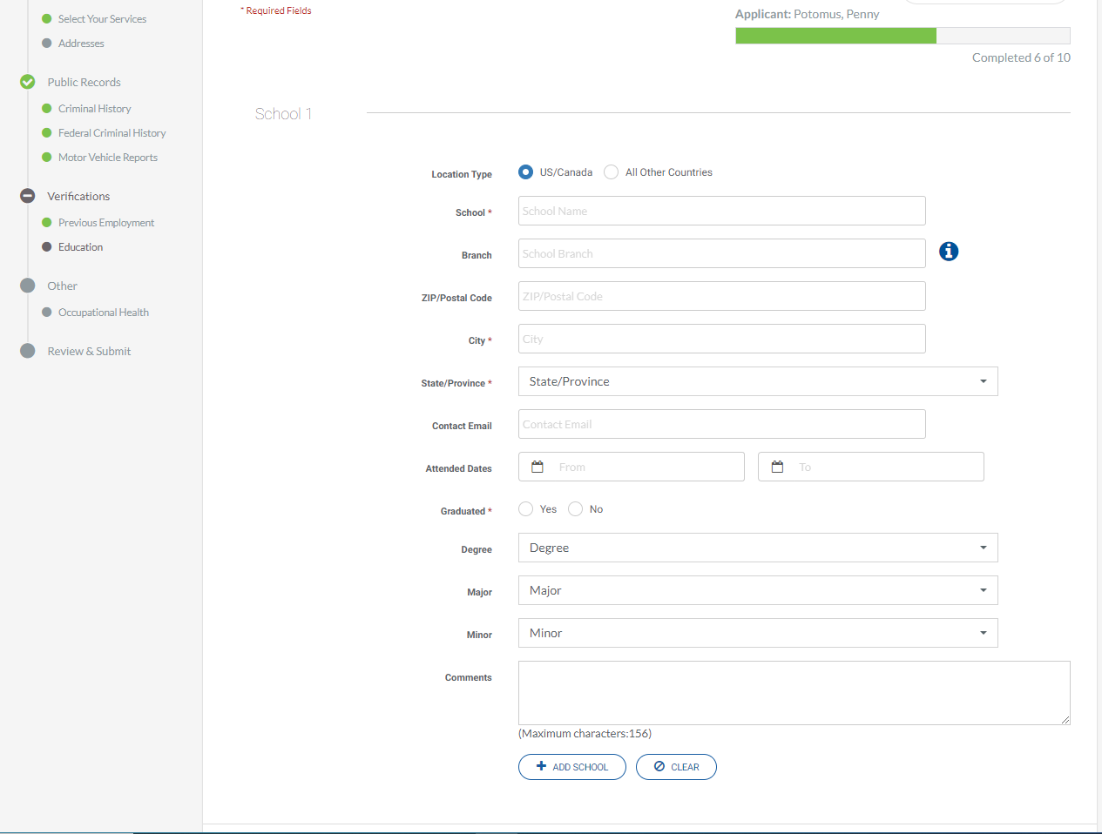
EDUCATION
STANDARD ENTRY

Slide 24
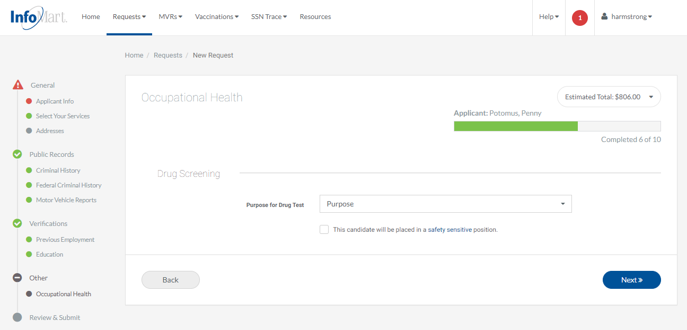
OCCUPATIONAL HEALTH
STANDARD ENTRY

Slide 25
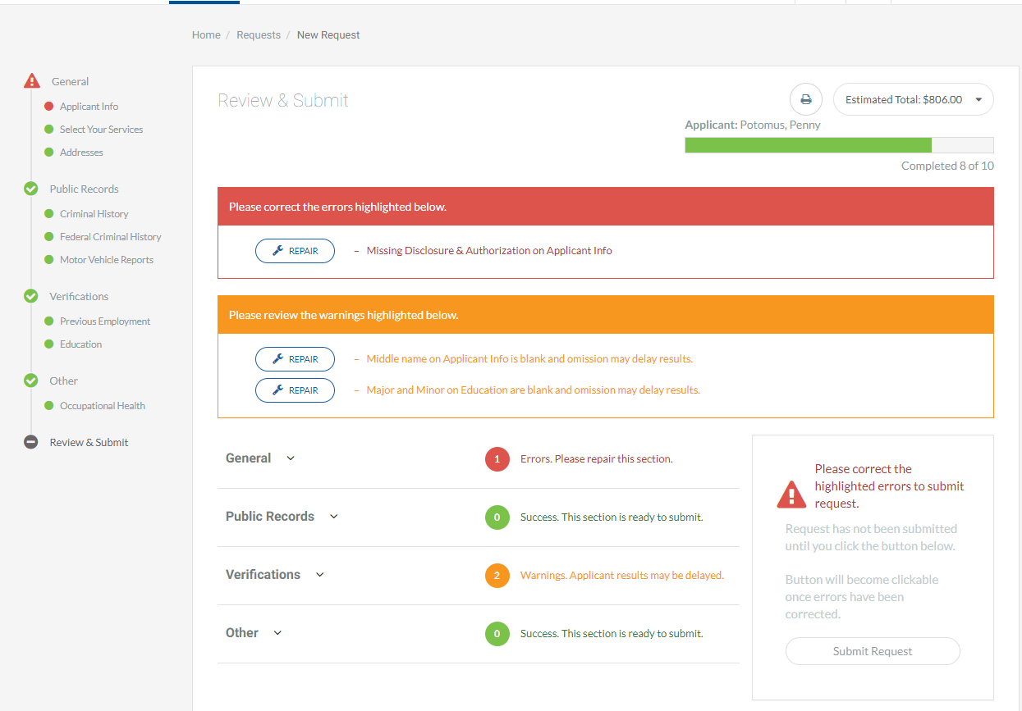
REVIEW REQUEST
STANDARD ENTRY
When all service screens have been completed, the system will bring you to the review & submit screen.
Any missing information will be indicated with a big red box prompting you to repair something. You will need to click repair to go back and resolve missing/incorrect data before you can submit.
If an orange box appears, it means that something that could delay results is missing, but it is not required before submitting.
As you can see above, the price forecast can also be expanded and pinned to the sidebar by clicking on the dropdown arrow and clicking the pin.
Prices will vary from what is shown.

Slide 26
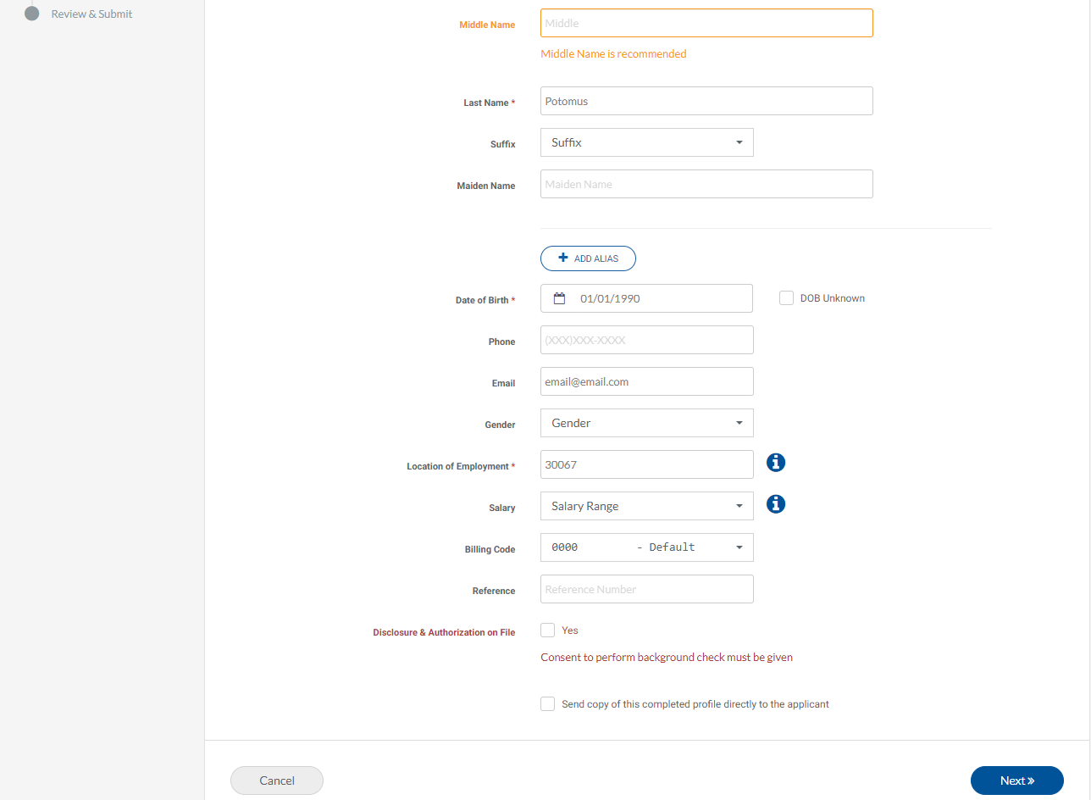
CORRECTING ERRORS
STANDARD ENTRY
Correct any errors found before returning to the review & submit page

Slide 27
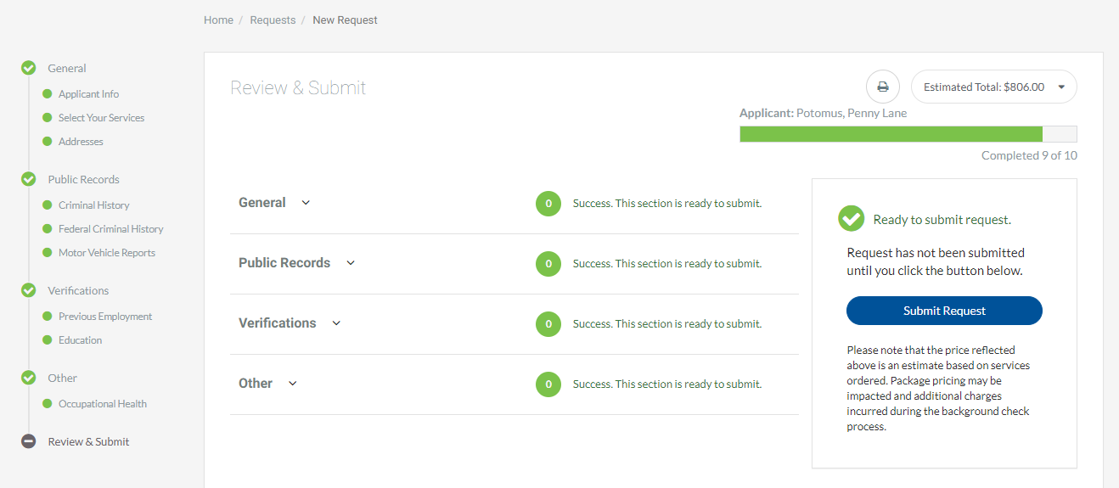
SUBMIT REQUEST
STANDARD ENTRY
Once everything has been provided and reviewed (we strongly suggest that you double check the information by clicking on each arrow above), you will be able to submit your request by clicking on the blue submit request button on the right side of the screen.

Slide 28
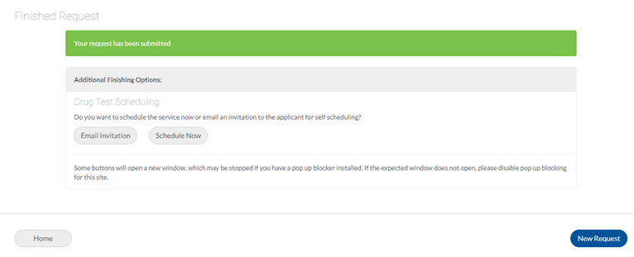
SCHEDULING A DRUG TEST
STANDARD ENTRY

Slide 29

ASAP CONNECT
Notes:
Elliot –

Slide 30
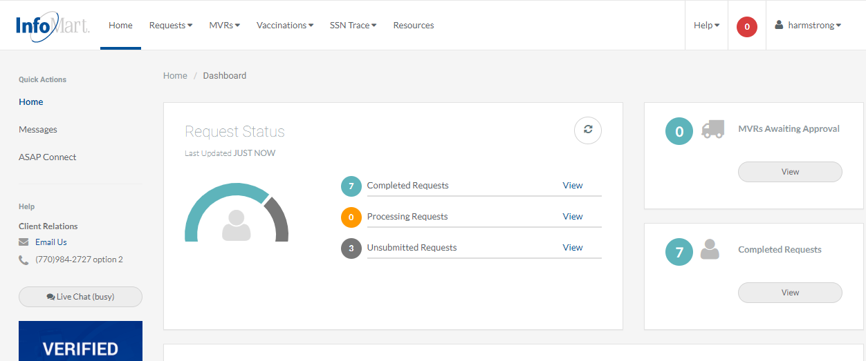
HOMEPAGE
ASAP CONNECT
If you would rather use the candidate-facing ASAP Connect feature to order the background check, click ASAP Connect.

Slide 31
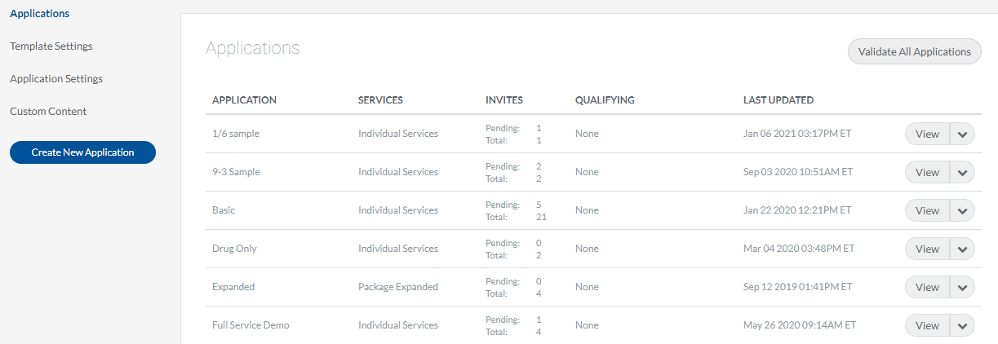
ASAP CONNECT
ASAP CONNECT
From this screen, you will click on the application that you would like to send to your candidate. These applications will have been set up based on position, service package, department, etc., based on your company’s request.

Slide 32
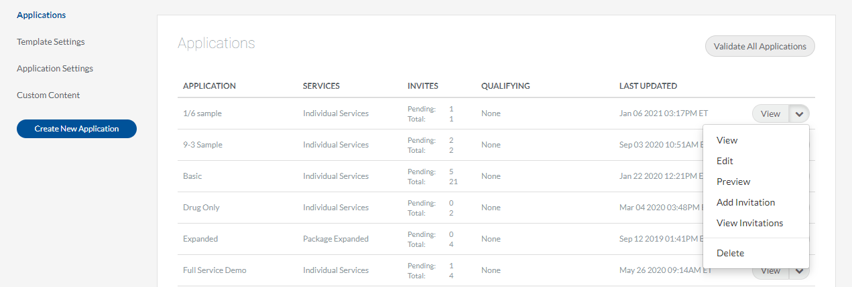
ASAP CONNECT
ASAP CONNECT
To begin the process of ordering a background check, click the drop-down arrow beside view and then choose add invitation.
Choosing a package will automatically select the appropriate services included in that package.
To view the invitations already sent out to the applicants, please choose view invitation.

Slide 33
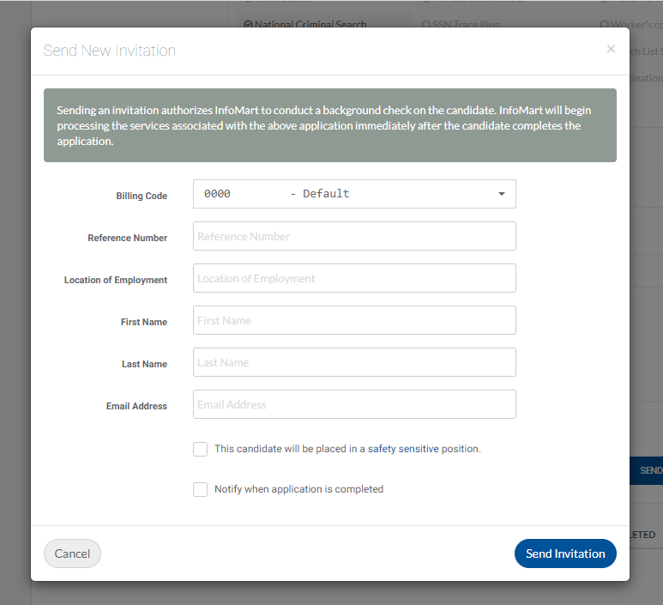
ASAP CONNECT
ASAP CONNECT
If you click add invitation, you will be prompted to complete the send new invitation section.
If applicable, billing codes for your account will be preloaded into the drop-down menu.
The reference number field is freeform. Whatever you provide there will appear on the invoice alongside this candidate’s name.
Only the location of employment zip code, first name, last name, and email address are required fields.
If you would like to be notified when the candidate completes the application, please check the notify box.
Click send invitation when you have finished.

Slide 34
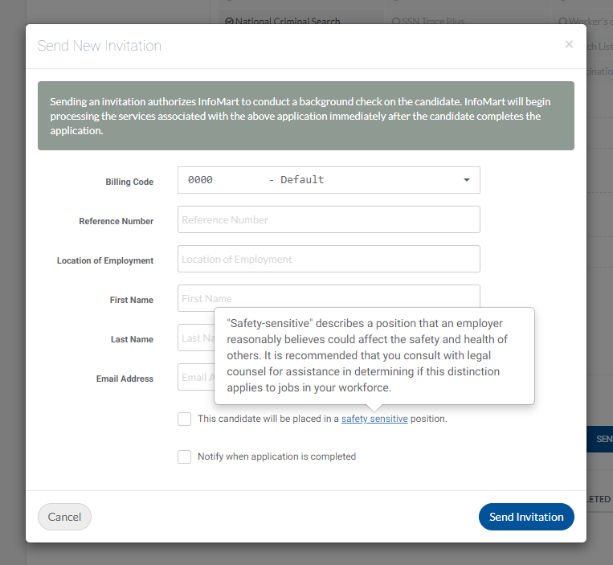
ASAP CONNECT
ASAP CONNECT
“Safety-sensitive” check box – examples include employment that is regulated by the DOT, FAA, and FMCSA; home-facing workers; etc.

Slide 35
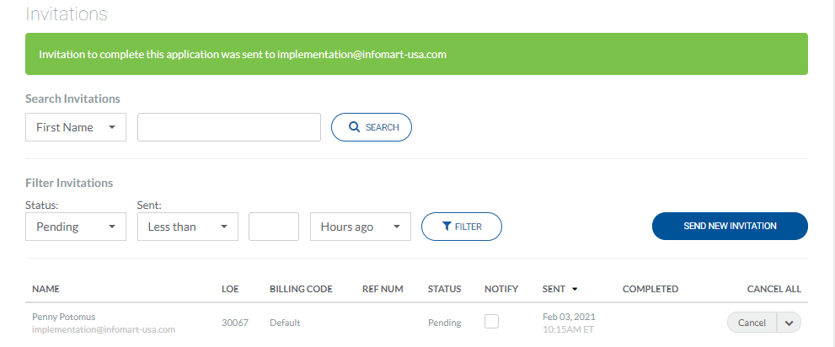
ASAP CONNECT
ASAP CONNECT
After you clicked send invitation, you will be taken into this screen showing that the invitation has been sent to the candidate (displayed at the bottom of the screen).

Slide 36
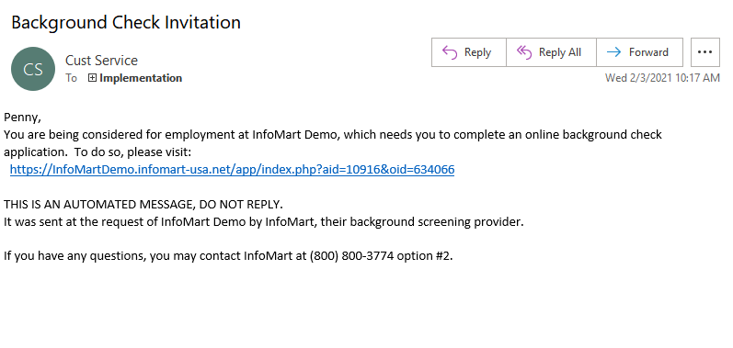
ASAP CONNECT
ASAP CONNECT
Once sent, your candidate will receive an email invitation to complete the background check application and online disclosure/authorization.
This is also the email your candidate will receive if an ATS integration does not provide 100% of information required to complete the search requested.

Slide 37
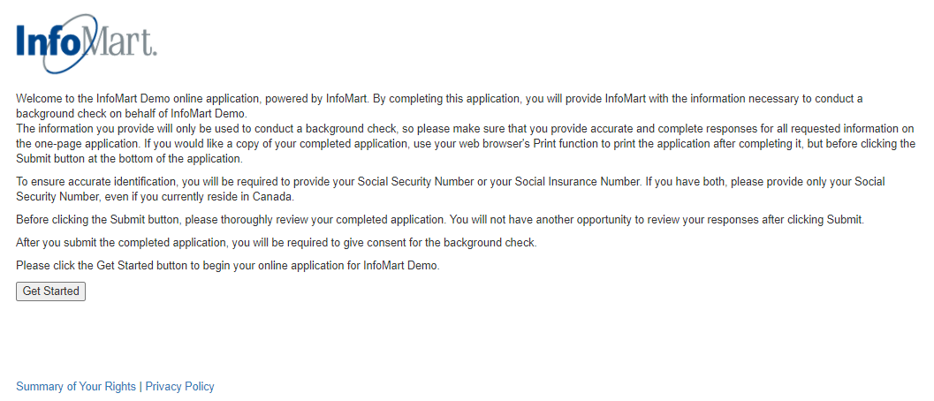
ASAP CONNECT
ASAP CONNECT
This landing page and your account’s applications can be branded with your company’s logo and banner. You may also customize application language.

Slide 38
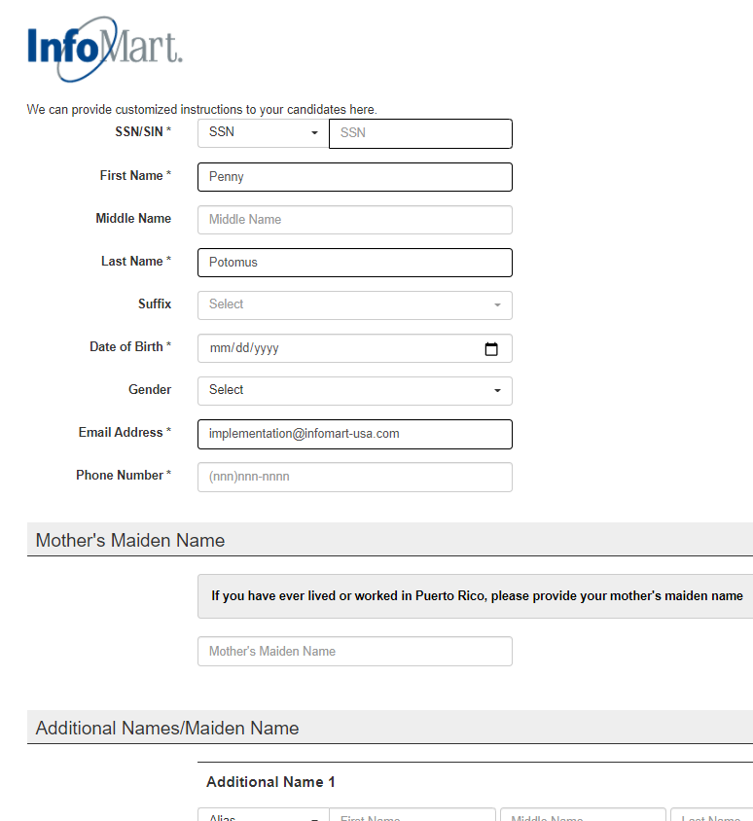
ASAP CONNECT
ASAP CONNECT
The candidate will only be asked to provide information related to the specific set of services requested. The site is mobile optimized and will provide an easy and smooth candidate experience on any mobile device, including phones and tablets.

Slide 39
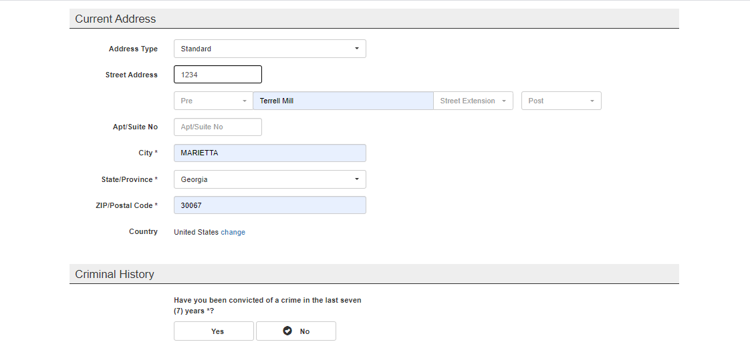
ASAP CONNECT
ASAP CONNECT

Slide 40
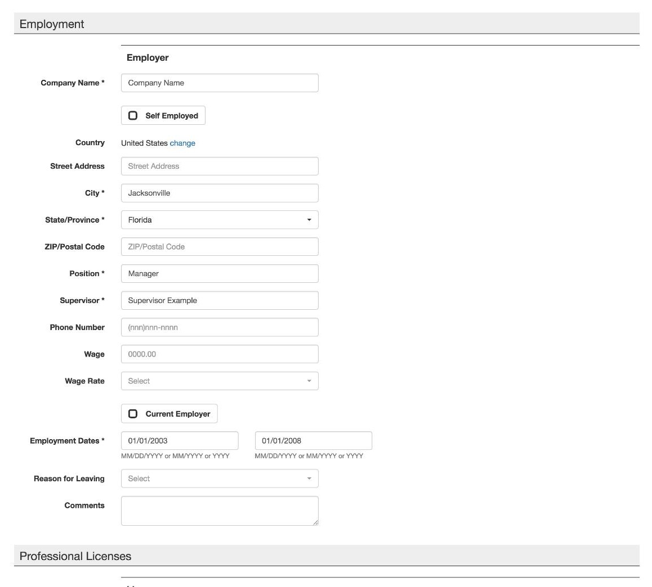
ASAP CONNECT
ASAP CONNECT
As mentioned, only relevant data will be collected based on the services requested.
When providing their employment history, candidates are required to confirm that InfoMart has their permission to contact any current employers. If they do not agree to this, that information will not be provided to our employment team to avoid any mistakes or jeopardization of their current employment.

Slide 41
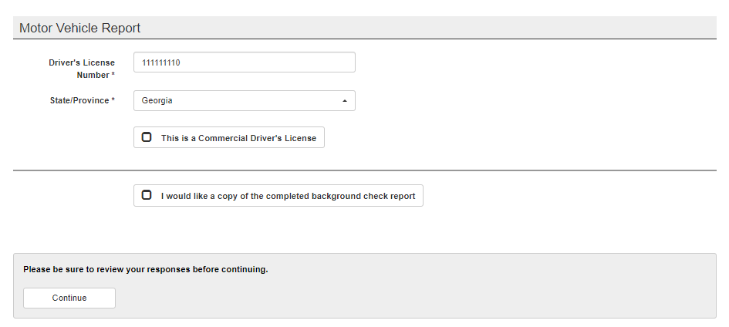
ASAP CONNECT
ASAP CONNECT
Candidates can request a copy of their completed reports before they submit and move on to the disclosure and authorization form. This will be emailed to them directly at no additional charge.

Slide 42
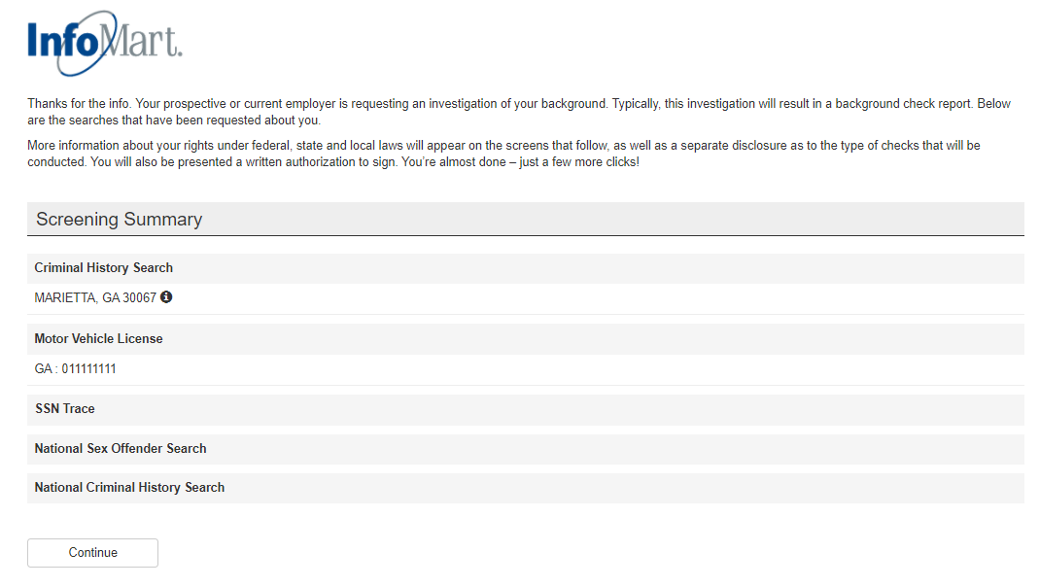
ASAP CONNECT
ASAP CONNECT

Slide 43
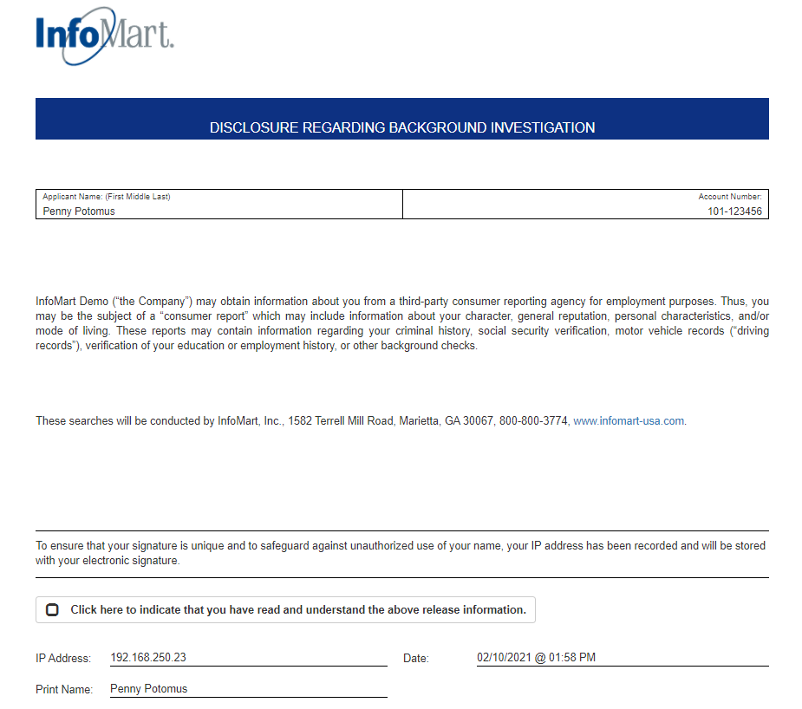
ASAP CONNECT
ASAP CONNECT
This is an example of our default disclosure form, which the candidate is required to submit before the background check begins. It can be customized if you have your own form.

Slide 44
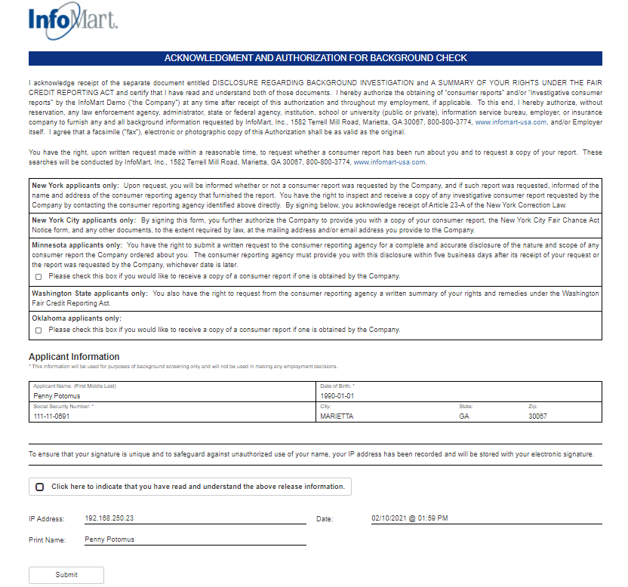
ASAP CONNECT
ASAP CONNECT
The separate acknowledgement and authorization form will be provided next, again requiring the candidate to check a box and submit to move forward.

Slide 45
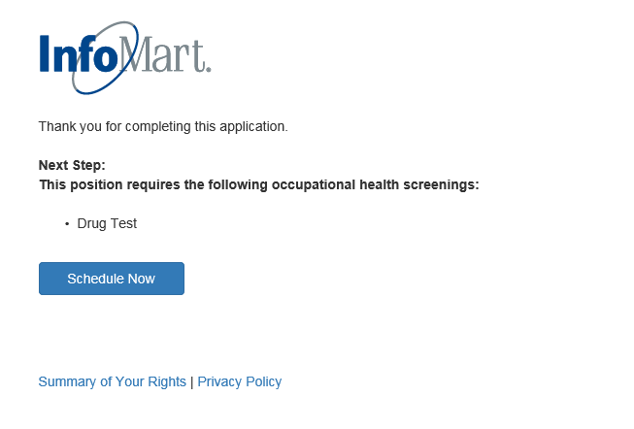
ASAP CONNECT
ASAP CONNECT
Once completed, the candidate is directed to a thank you screen, letting them know that their ASAP Connect request has been completed. They will be prompted to schedule a drug test when applicable.

Slide 46
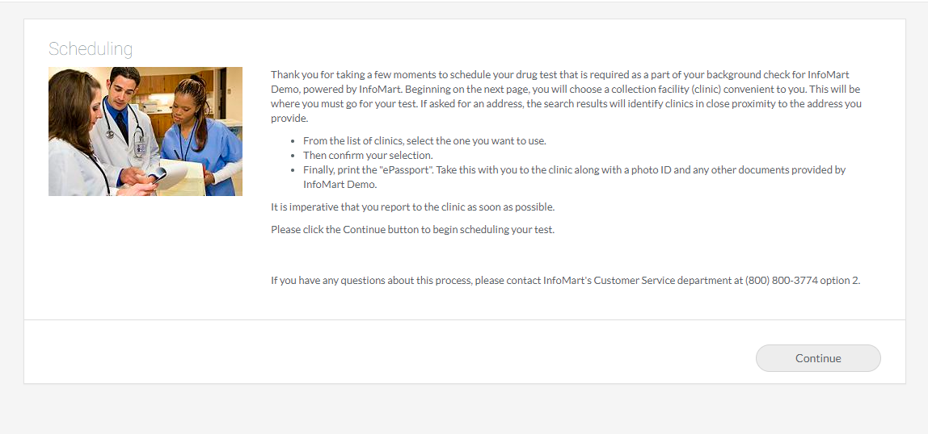
SCHEDULE DRUG TEST
ASAP CONNECT

Slide 47

ORDER STATUS
Notes:
Erica

Slide 48
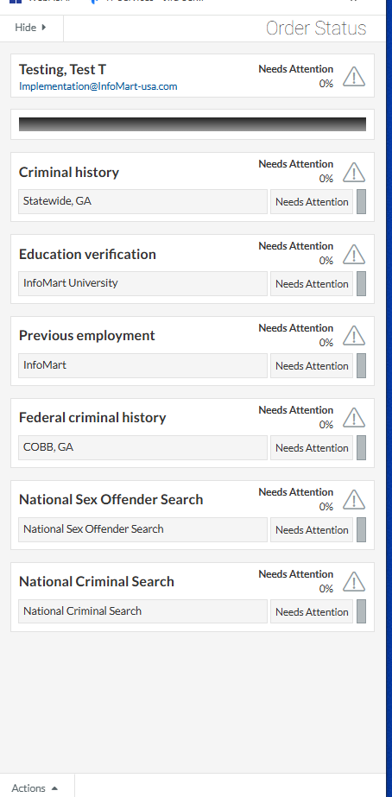
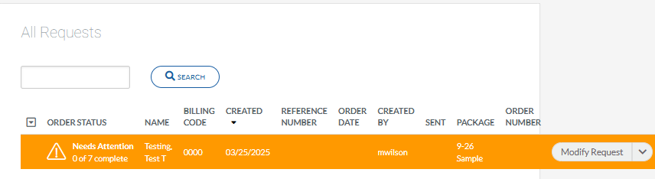
HOMEPAGE/ STATUS
ORDER STATUS
If the request is unsubmitted on the homepage under the order status header you will see the needs attention icon.
If you click on needs attention or 0 of _ complete, the order status bar will appear.
If the request has not been submitted, all services requested are marked needs attention.
To close the order status bar, click hide.

Slide 49
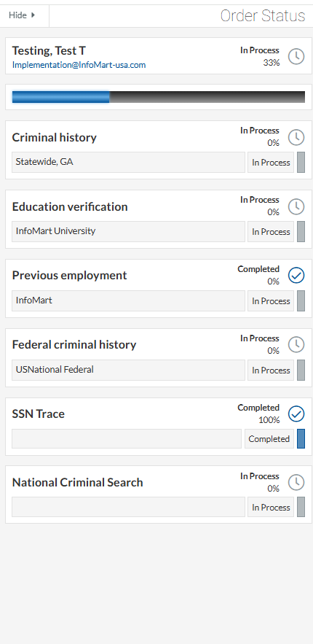
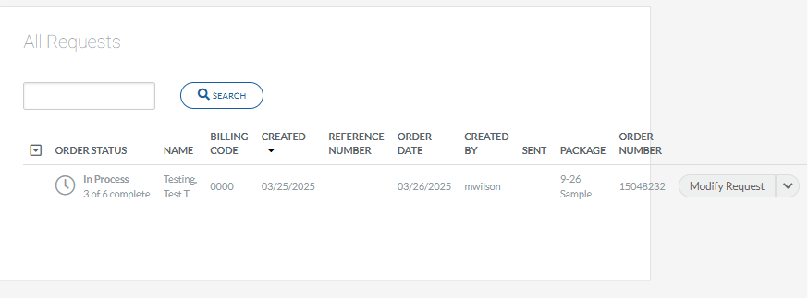
HOMEPAGE/ STATUS
ORDER STATUS
Once the request is submitted, the order status will change to in process.
If you click in process or 0 of _ complete, the order status will appear, displaying which services are in process or completed.

Slide 50
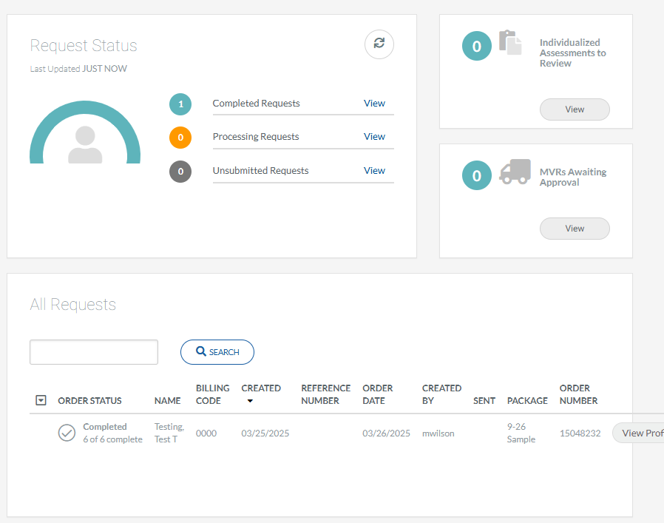
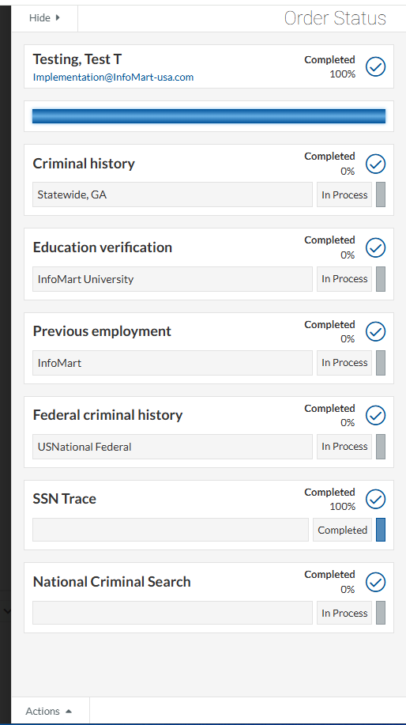
HOMEPAGE/ STATUS
ORDER STATUS
Once the request completes, the order status will change to completed and the number of completed services will update (for example, 6 of 6 completed).
Click completed or the check box icon to open the status tracker for that request.

Slide 51
RESULTS / REPORTING
Notes:
Erica

Slide 52
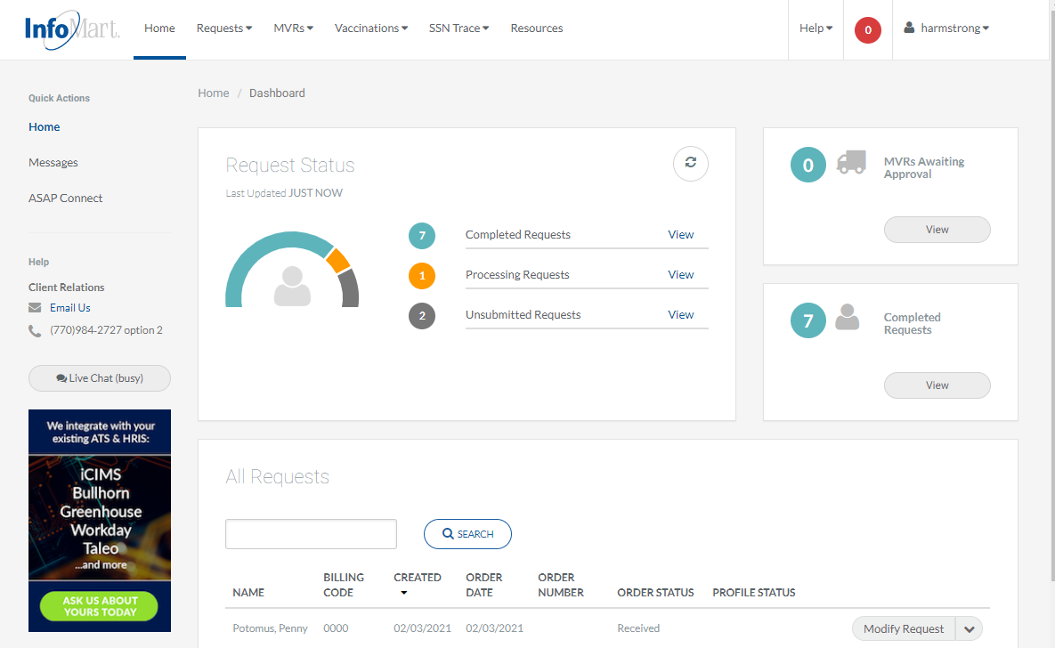
HOMEPAGE/ STATUS
RESULTS / REPORTING
You can search for any background requests you have ordered by typing in the box under all requests.
Action options can be viewed by clicking on the box/arrow next to the candidate’s name (options detailed on the next slide).

Slide 53
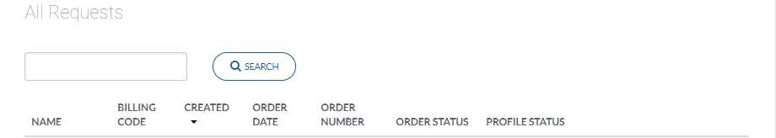
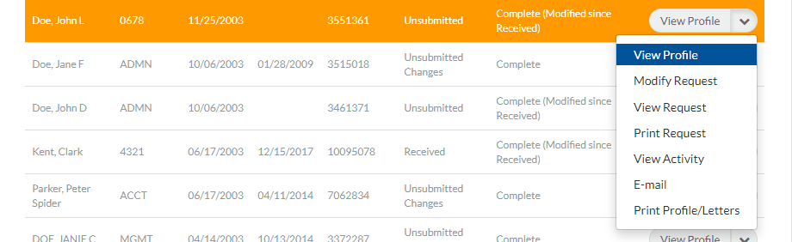
VIEW/EMAIL RESULTS
RESULTS / REPORTING
Next Action Options
Modify Request: Change information and resubmit
View Profile: Open and review a completed background report
View Request: View the information provided at the time of order
View Activity: View timeline of this process in our system
Email: Email one of the following items:
- Completed profile (background check results)
- Pre-adverse/adverse action letters
- Consumer rights
- Consumer notification
Click View Profile to see results.

Slide 54

APPLICANT PROFILE
RESULTS / REPORTING

Slide 55

PRE-ADVERSE & ADVERSE ACTION LETTERS
RESULTS / REPORTING
After reviewing the candidate profile, the InfoMart system offers the ability to generate pre-adverse and adverse action letters.
From the same dropdown used to view profile, select email to see pre-adverse and adverse action letters.

Slide 56

REPORTS
RESULTS / REPORTING
Customized reports can be found on the top of the homepage by clicking reports.

Slide 57
If you have any questions, please contact our customer service team using the contact information below, and they will direct you to your dedicated representative.
Client Services
CustomerService@InfoMart-usa.com
770 984 2727 opt 2

