Slide 1
Training Demo:
Cox Vendor Clients
May 2017

Slide 2
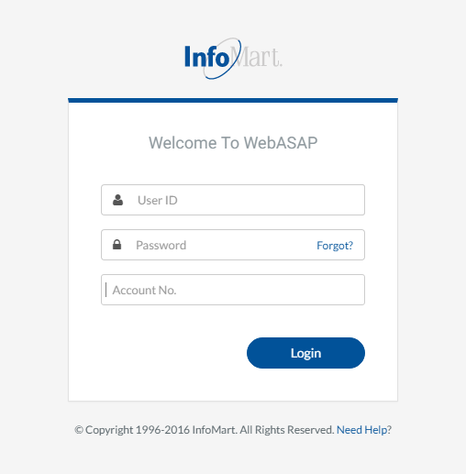
WebASAP Login
WebASAP Address
https://www.infomart-usa.com/webasap/
You will be prompted to provide your user ID, password & account number each time you log in. Please note that the password is case-sensitive and needs to be entered exactly as it was provided.

Slide 3
Permissible Purpose
1 out of each 5 times you log in, you will be required to agree to a Certification of Permissible Purpose and Intent of Use. This is where you confirm that you will only be running background checks for the reasons you stated when signing up for an account. Click I Agree to continue.

Slide 4
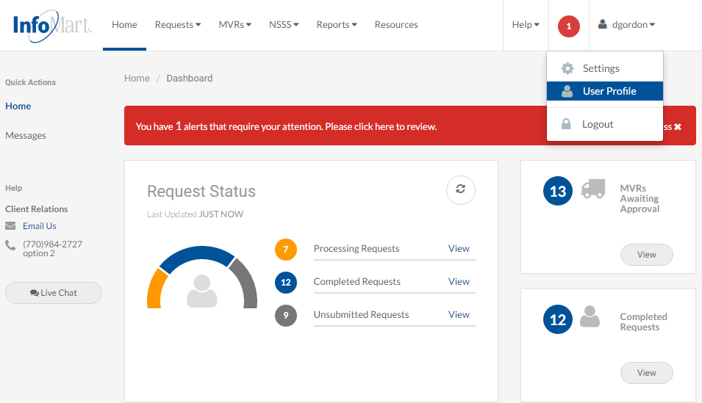
Update/Change Password
To update/change your password, click on the arrow next to your User ID in the upper right corner and select User Profile.

Slide 5
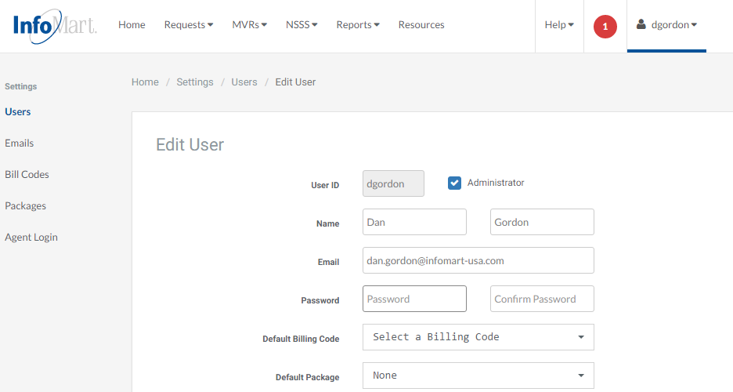
Update/Change Password
You can then enter in a new password and confirm. Please note that the password must be at least 6 characters long and consist of a combination of letters, numbers and one special character, such as an exclamation point.

Slide 6
Update/Change Password
Once you have entered in your new password, select Save at the bottom of the page.

Slide 7
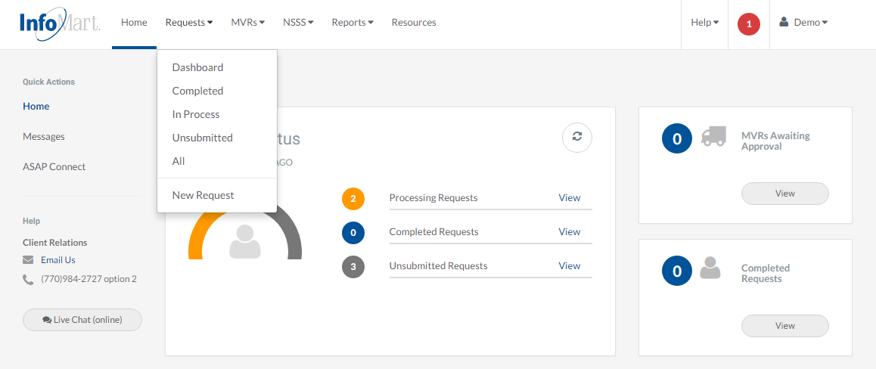
Homepage/Status
To send your candidate an invitation to complete their background order, select ASAP Connect on the left side of the home screen

Slide 8
Package Selection
Choose the appropriate package you want to send to your candidate by clicking on the package name from the dropdown.

Slide 9
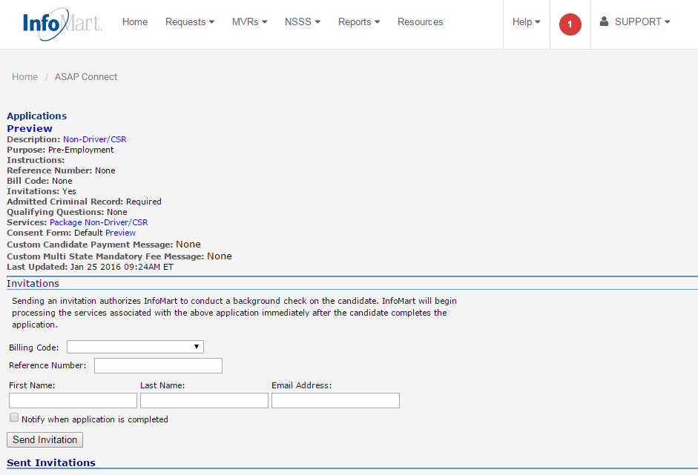
Invitations
The Invitations section will need to be completed with the candidate’s first name, last name, and email address. Click Send Invitation.
Your candidate will receive an email invitation to complete the background check application, online consent, and drug scheduling.

Slide 10
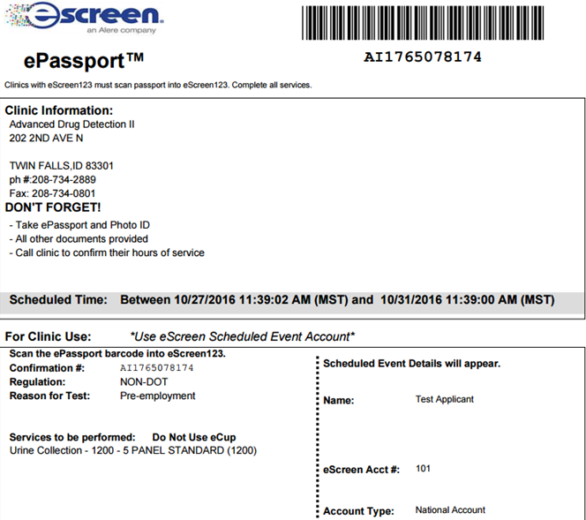
Drug Screening ePassport
When the candidate has completed the process, an ePassport document will be generated, which the candidate will then need to print out and take with them when reporting for drug screening. This document will give the exact time frame they have to report for screening, as well as the clinic name, address and phone number. Please note, Cox requires all drug tests to be performed within 48 hours.

Slide 11
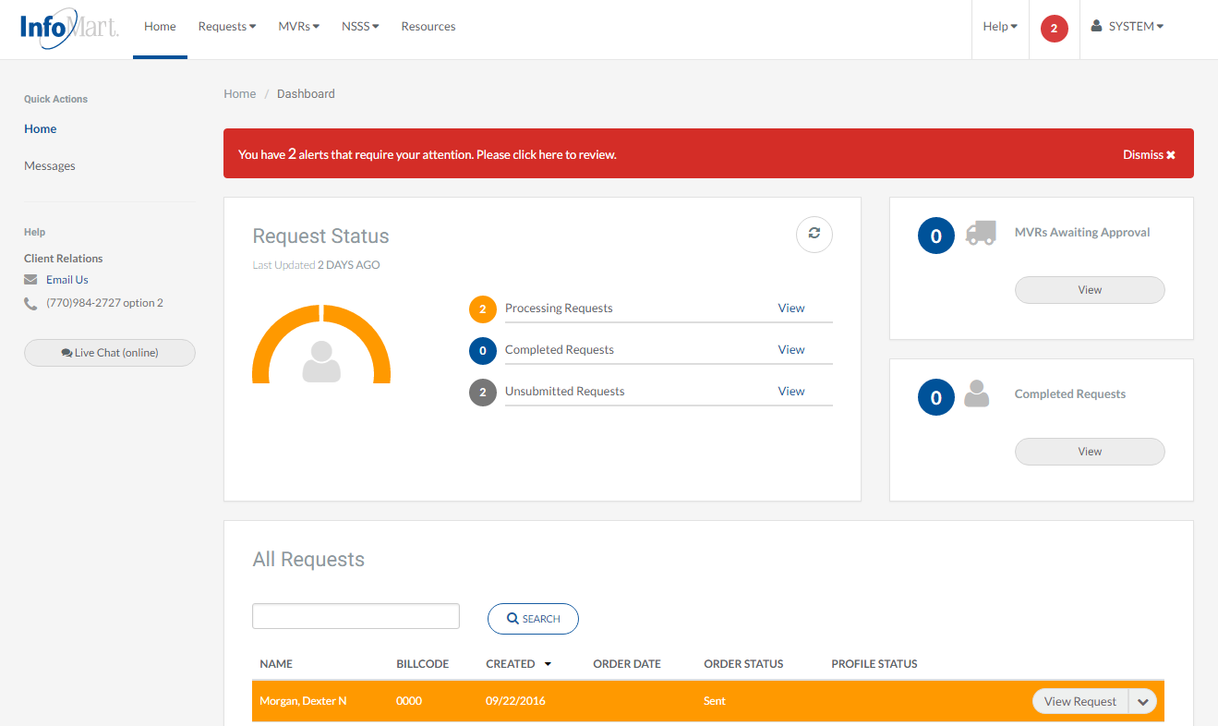
Homepage/Status
Once the background check has completed, you will receive a notification that it is available. You can also view all completed results by searching the “all requests” section of the WebASAP homepage.

Slide 12
Homepage/Status
Once you have selected the candidate you want to review, action options can be viewed by clicking on the box/arrow next to the candidate’s name (options detailed on the next slide).

Slide 13
View/Email Results
Next Action Options
Modify Request: Change information for search and resubmit
View Profile: Open and review a completed background report
View Request: View the information provided at the time of order
View Activity: View timeline of this process in our system
Email/Print: Email/Print one of the following items
Completed Profile (Background check)
Pre-Adverse/Adverse Action Letters
Consumer Rights
Consumer Notification
Click View Profile to see results.

Slide 14
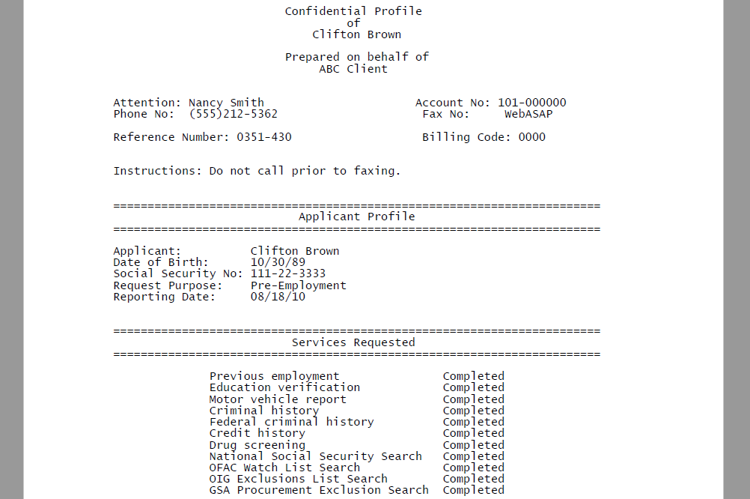
Applicant Profile
Please keep in mind as you review each report that these contain private and confidential information and should be treated as such.
The Applicant Profile section is the information as it was provided to InfoMart. DOB and SSN will be truncated, but if you notice anything incorrect, please contact us ASAP.

Slide 15
Contact
If you ever have questions about any part of the process with InfoMart, there is a dedicated team of Corporate Account Representatives trained to help Cox Vendors like your account. Their contact information is below.
Please note, Cox requires that the drug tests be scheduled and taken within 48 business hours of the background request being ordered.
The Cox Vendor Team
InfoMart®
1-877-984-0957
CoxVendor@infomart-usa.com

