Slide 1
Training Demo:
Mary Kay Vendor Clients

Slide 2
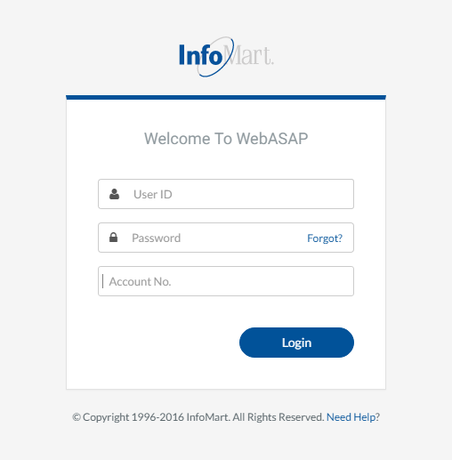
WebASAP Login
WebASAP Address
https://www.infomart-usa.com/webasap/
You will be prompted to provide your user ID, password & account number each time you log in. Please note that the password is case-sensitive and needs to be entered exactly as it was provided.

Slide 3
Permissible Purpose
1 out of each 5 times you log in, you will be required to agree to a Certification of Permissible Purpose and Intent of Use. This is where you confirm that you will only be running background checks for the reasons you stated when signing up for an account. Click I Agree to continue.

Slide 4
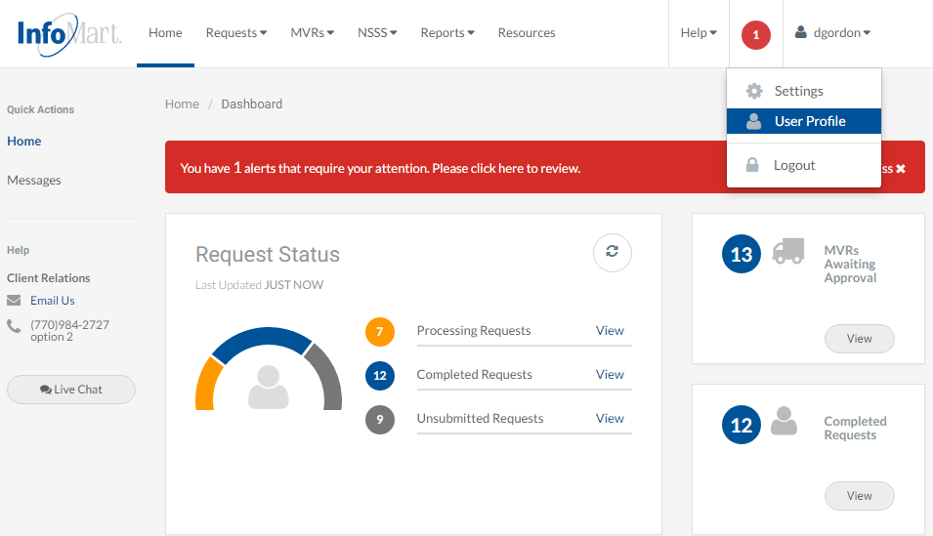
Update/Change Password
To update/change your password, click on the arrow next to your User ID in the upper right corner and select User Profile.

Slide 5
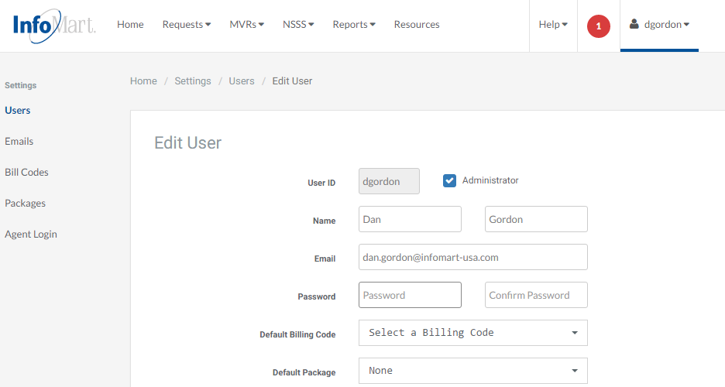
Update/Change Password
You can then enter in a new password and confirm. Please note that the password must be at least 6 characters long and consist of a combination of letters, numbers and one special character, such as an exclamation point.

Slide 6
Update/Change Password
Once you have entered in your new password, select Save at the bottom of the page.

Slide 7
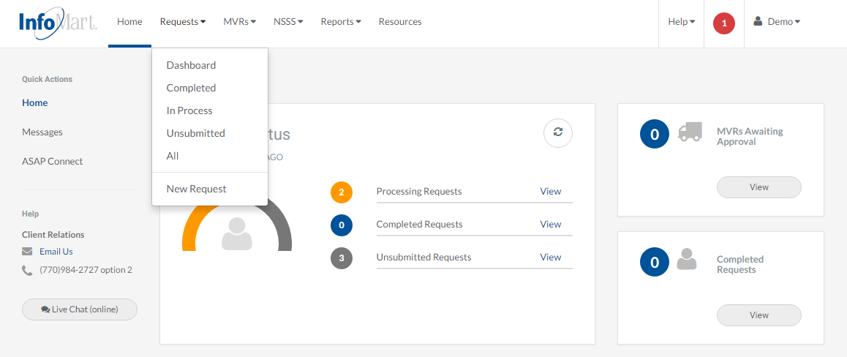
Homepage
To begin the process of ordering a background check, click Requests at the top of the page, then choose New Request.

Slide 8
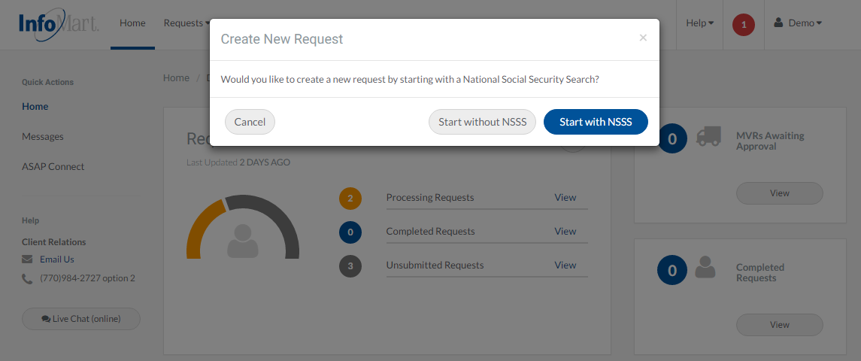
Creating A Request
You will be prompted to indicate whether you would like to run the National Social Security Search (NSSS) first. The NSSS tool discovers previous addresses/jurisdictions for conducting a criminal search, and it is included in most criminal background check packages.
Mary Kay Vendor packages require this service, so please choose Start with NSSS.

Slide 9
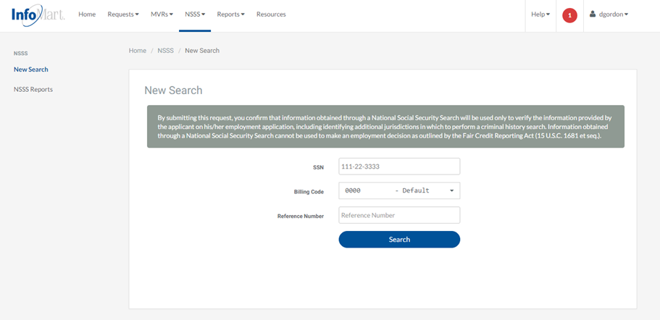
NSSS Submission
Enter your applicant’s Social Security Number.
If applicable, Billing Codes for your account will be preloaded into the dropdown menu.
The Reference Number field is freeform. Whatever you provide there will appear on the invoice alongside this candidate’s name.
Only the SSN is a required field, but many accounts have billing codes to select from. Click Search when you have finished.

Slide 10
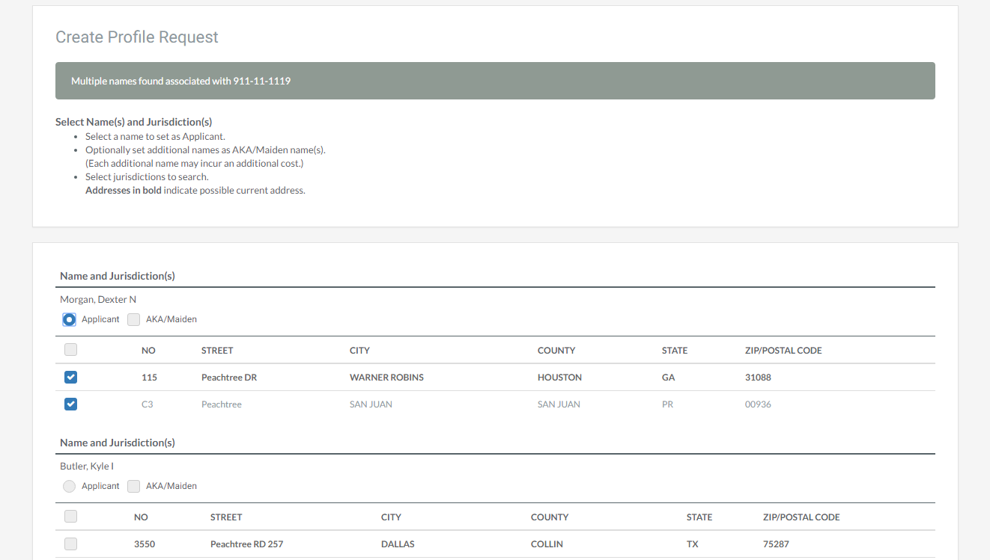
NSSS Results
If there are multiple names that come back from the NSSS search, they will show on this screen. Select the best match to your candidate’s name by marking Applicant. Follow the instructions provided on the top left of this screen before continuing.

Slide 11
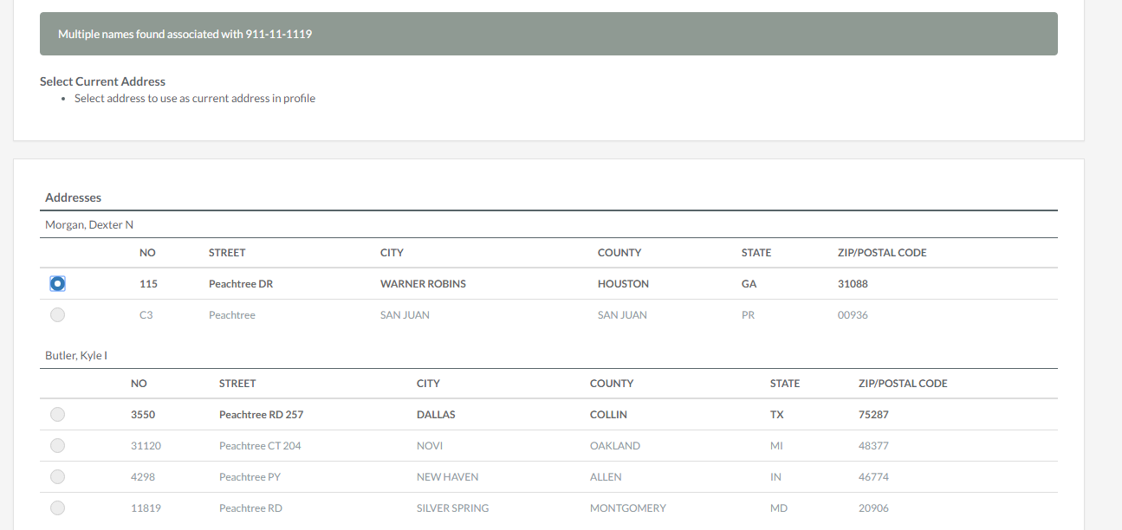
NSSS Results
More often than not, you will see the candidate’s current address on this screen. Select the button to the left of your candidate’s current address. If none of the addresses match, select the closest one – you will be able to modify the address later in the process.

Slide 12
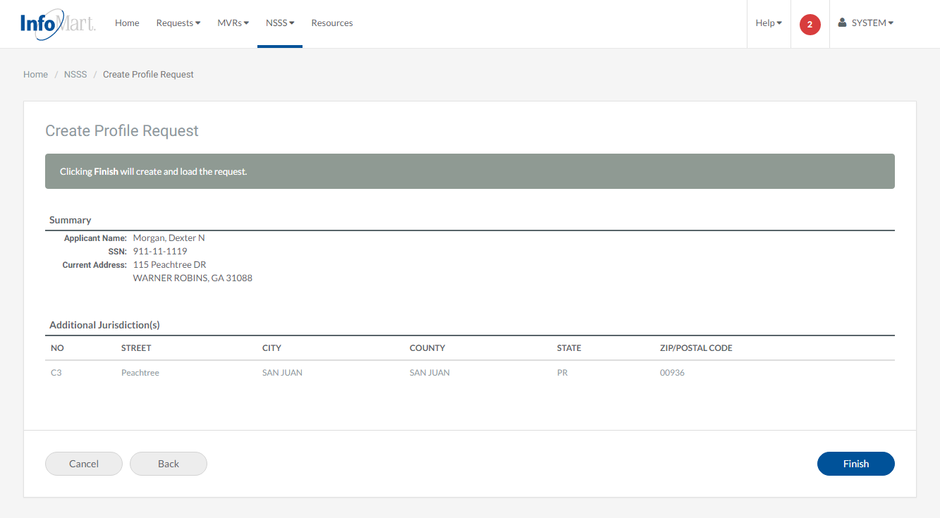
NSSS Review
The information provided thus far will be compiled for you to review. Click Finish if everything appears correct (again, if the address is wrong, you will be able to change it later), otherwise you can click on the Back button to make changes.

Slide 13
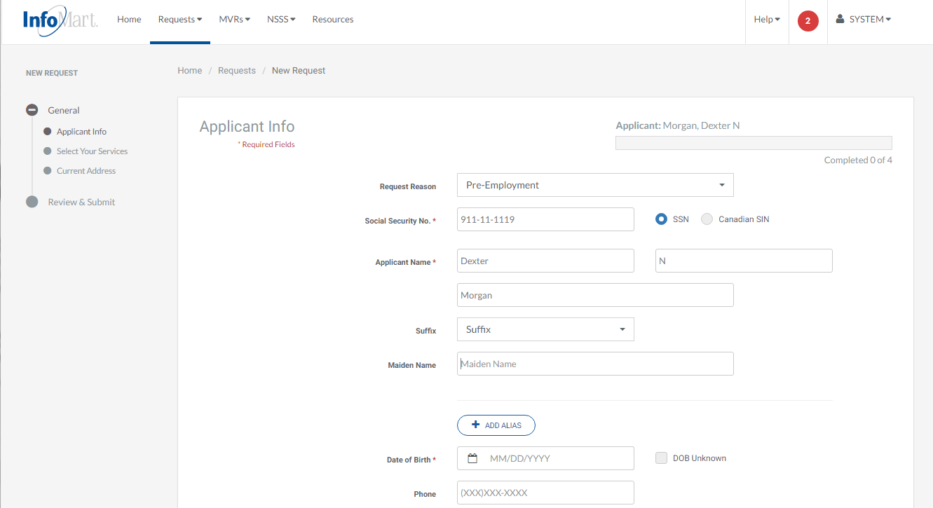
Applicant Information
The identifiers you have provided thus far will be pre-populated for you on the Applicant Info screen. If they were correct, they can be left as is, otherwise please update them as you go. For the best results, complete each field on this page, whether required or not.

Slide 14
Applicant Information
The Add Alias button should only be used if you want to run your check on more than one name (same goes with the maiden name above).
*Please note that screening additional names may incur additional charges.

Slide 15
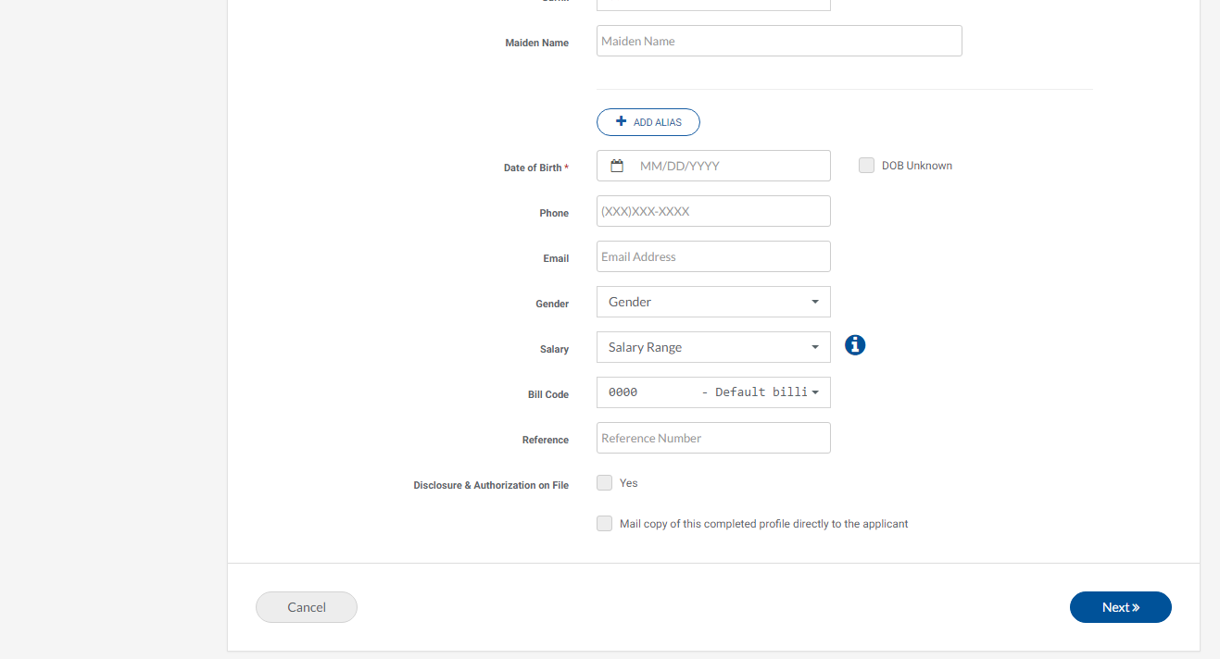
Applicant Information
Email Address should be that of the applicant, not the person ordering the check (unless they are the same person).
Disclosure & Authorization on File is a mandatory field; a background check cannot legally be requested on a candidate unless that individual has completed a Disclosure & Authorization form. Select Yes if you have the candidate’s signed Disclosure & Authorization form before clicking Next to continue.

Slide 16
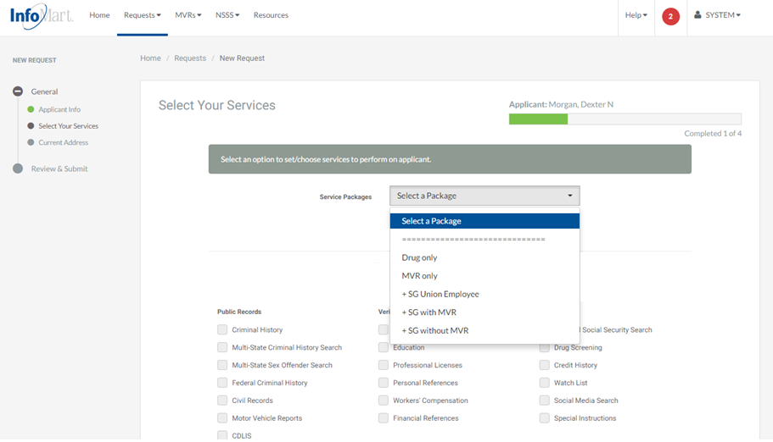
Package Selection
You can select the appropriate service package from the dropdown on the top of the screen.

Slide 17
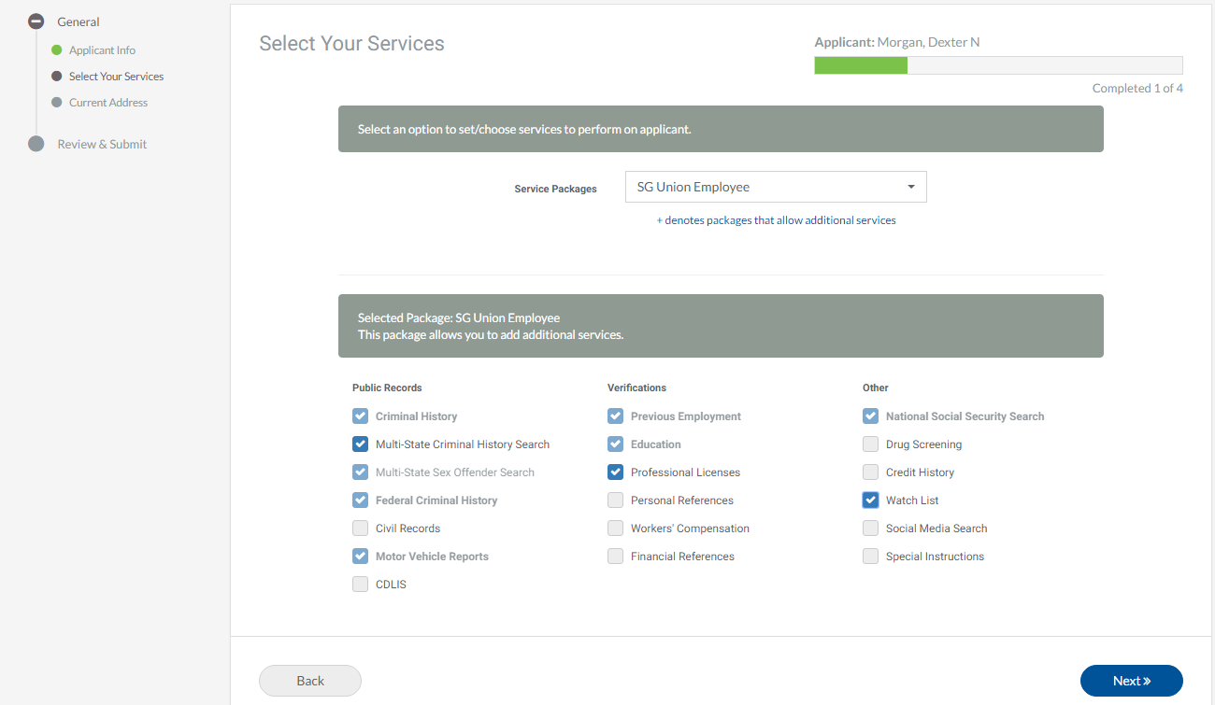
Package Selection
Choosing a package will automatically select the appropriate services included in that package below.
The package you select includes all services required by Mary Kay, so there is no need to select additional services.
*Keep in mind that the Multi-State Sex Offender Search will automatically be run when the Multi-State Criminal History is ordered, as it is included.

Slide 18
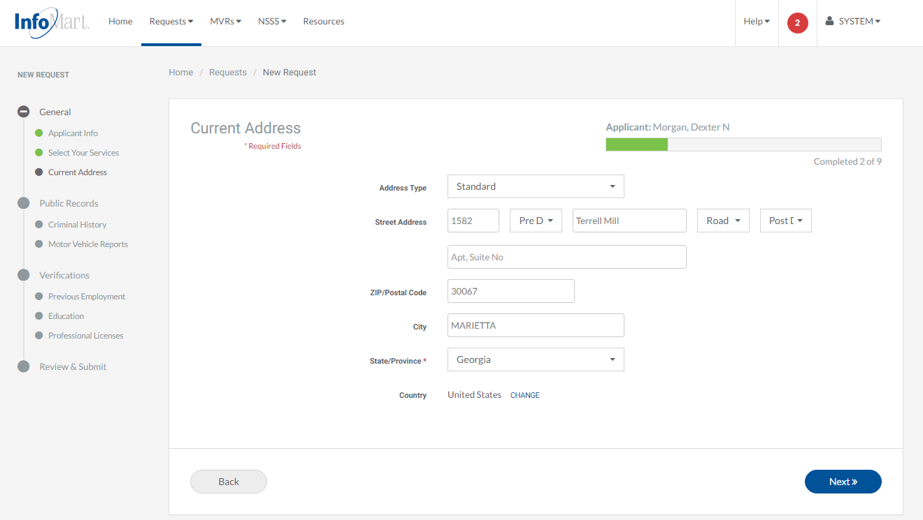
New Request Outline
Once you have selected the appropriate Service Package, the left navigation menu will start keeping track of your progress with the order, broken down by service requested.
Green circle next to an area means you have completed that section and the system does not recognize any errors or missing information.
Grey means you have not completed this part yet.
Red indicates that there is some sort of issue you will need to correct before you can submit the order

Slide 19
Current Address
The current address you selected during the NSSS process will pre-populate here. If it was correct, you can click Next. If not, please update it before clicking Next.

Slide 20
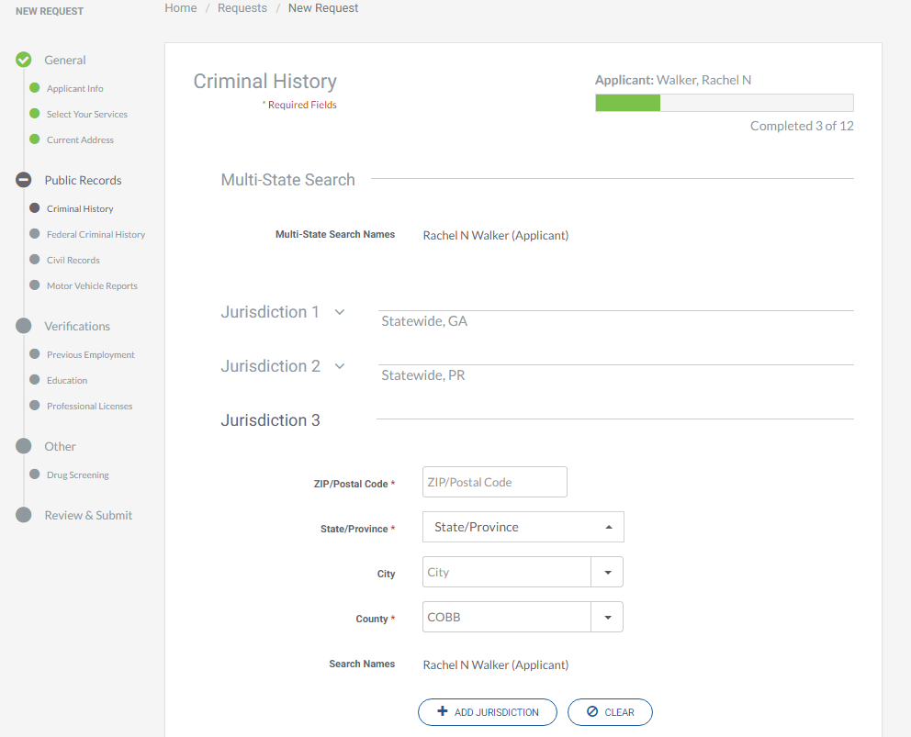
Adding Crim Jurisdictions
Jurisdictions discovered by the NSSS will populate automatically with the appropriate search. If you need to add a jurisdiction, there will be an additional jurisdiction space to do so automatically.

Slide 21
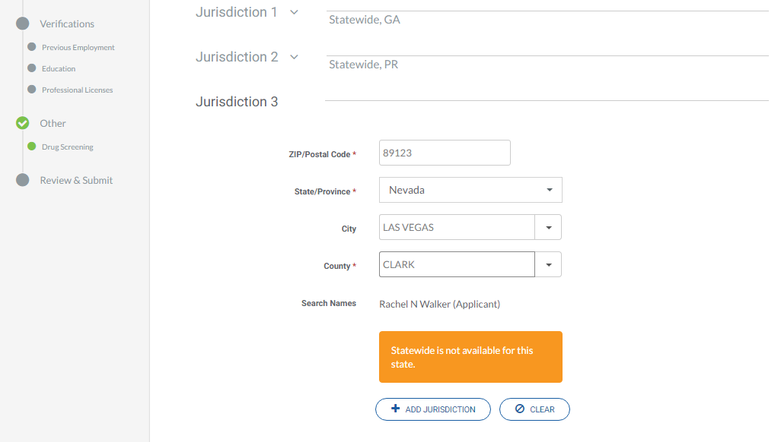
Adding Crim Jurisdictions
Enter the Zip Code and press your “Tab” key, and the rest of the fields will populate automatically.
If your account settings stipulate that you run statewide searches by default, it will automatically indicate “statewide” as the selected search type, if it is available.

Slide 22
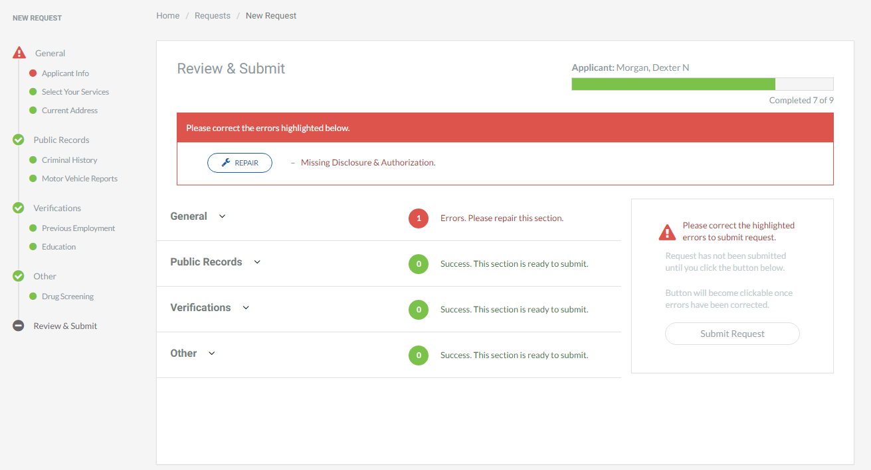
Reviewing Request
When all service screens have been completed, the system will bring you to the Review & Submit screen. Any missing information will be indicated with a big red box prompting you to repair something. You will need to click Repair to go back and resolve missing/incorrect data before you can submit.
If an orange box appears, it means that something that could delay results is missing, but it is not required before submitting.

Slide 23
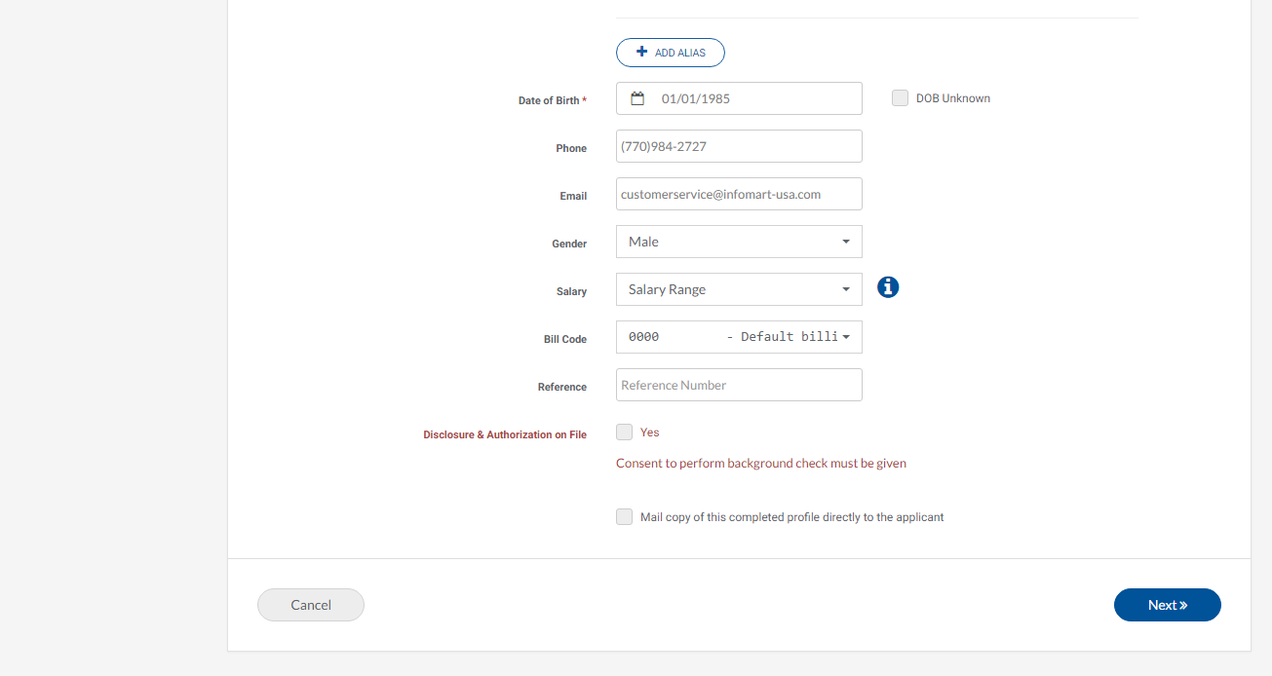
Correcting Errors
Correct any errors found before returning to the Review & Submit page, found just off the screen above.

Slide 24
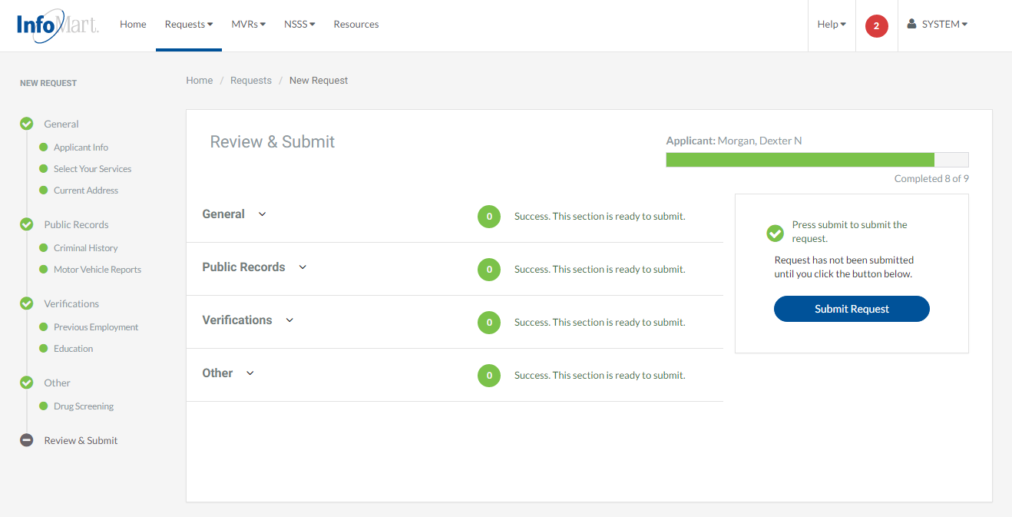
Submit Request
Once everything has been provided and reviewed (we strongly suggest that you double check the information by clicking on each arrow above) you will be able to submit your request by clicking on the blue Submit Request button on the right side of the screen.

Slide 25
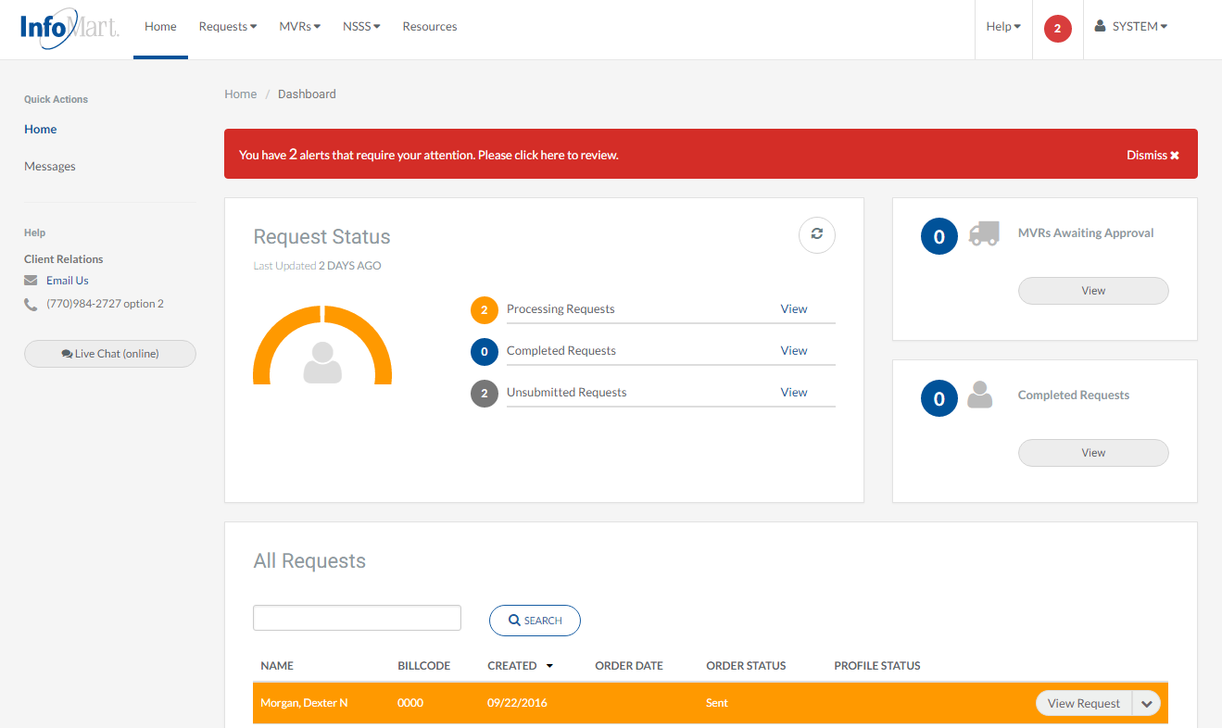
Homepage/Status
The Status screen is now available to you on the homepage. You can search for any background requests you have ordered by typing in the box under All Requests.

Slide 26
Homepage/Status
Action options can be viewed by clicking on the box/arrow next to the candidate’s name (options detailed on the next slide).

Slide 27
View/Email Results
Next Action Options
Modify Request: Change information for search and resubmit
View Profile: Open and review a completed background report
View Request: View the information provided at the time of order
View Activity: View timeline of this process in our system
Email/Print: Email/Print one of the following items
Completed Profile (Background check)
Pre-Adverse/Adverse Action Letters
Consumer Rights
Consumer Notification
Click View Profile to see results.

Slide 28
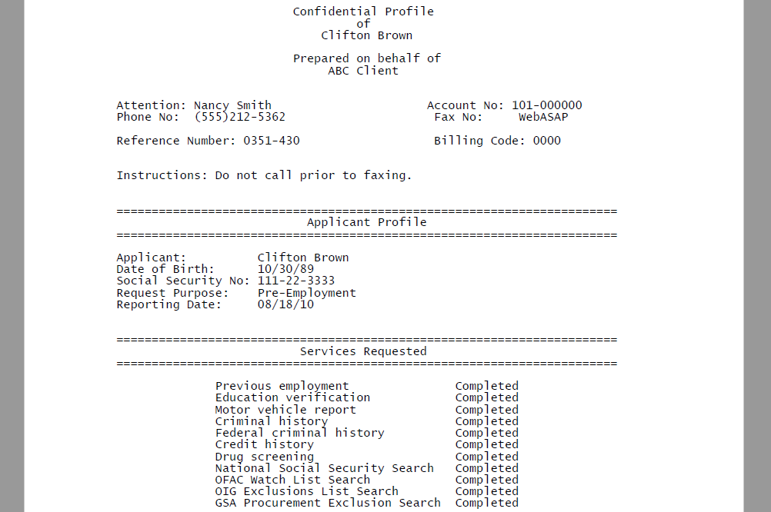
Applicant Profile
Please keep in mind as you review each report that these contain private and confidential information and should be treated as such.
The Applicant Profile section is the information as it was provided to InfoMart. DOB and SSN will be truncated, but if you notice anything incorrect, please contact us ASAP.

Slide 29
Contact
If you ever have questions about any part of the process with InfoMart, there is a dedicated team of Client Relations Representatives trained to help Mary Kay Vendors.
InfoMart Client Relations
InfoMart®
770-984-2727, ext. 2000
CustomerService@infomart-usa.com

